Slide 1
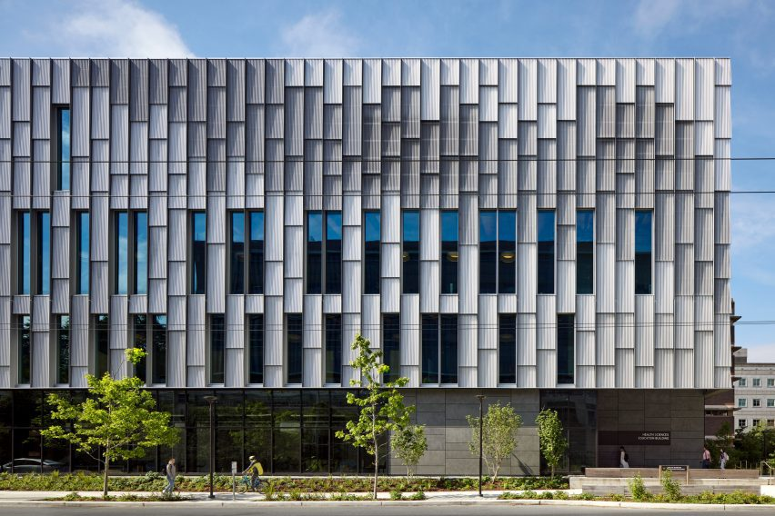
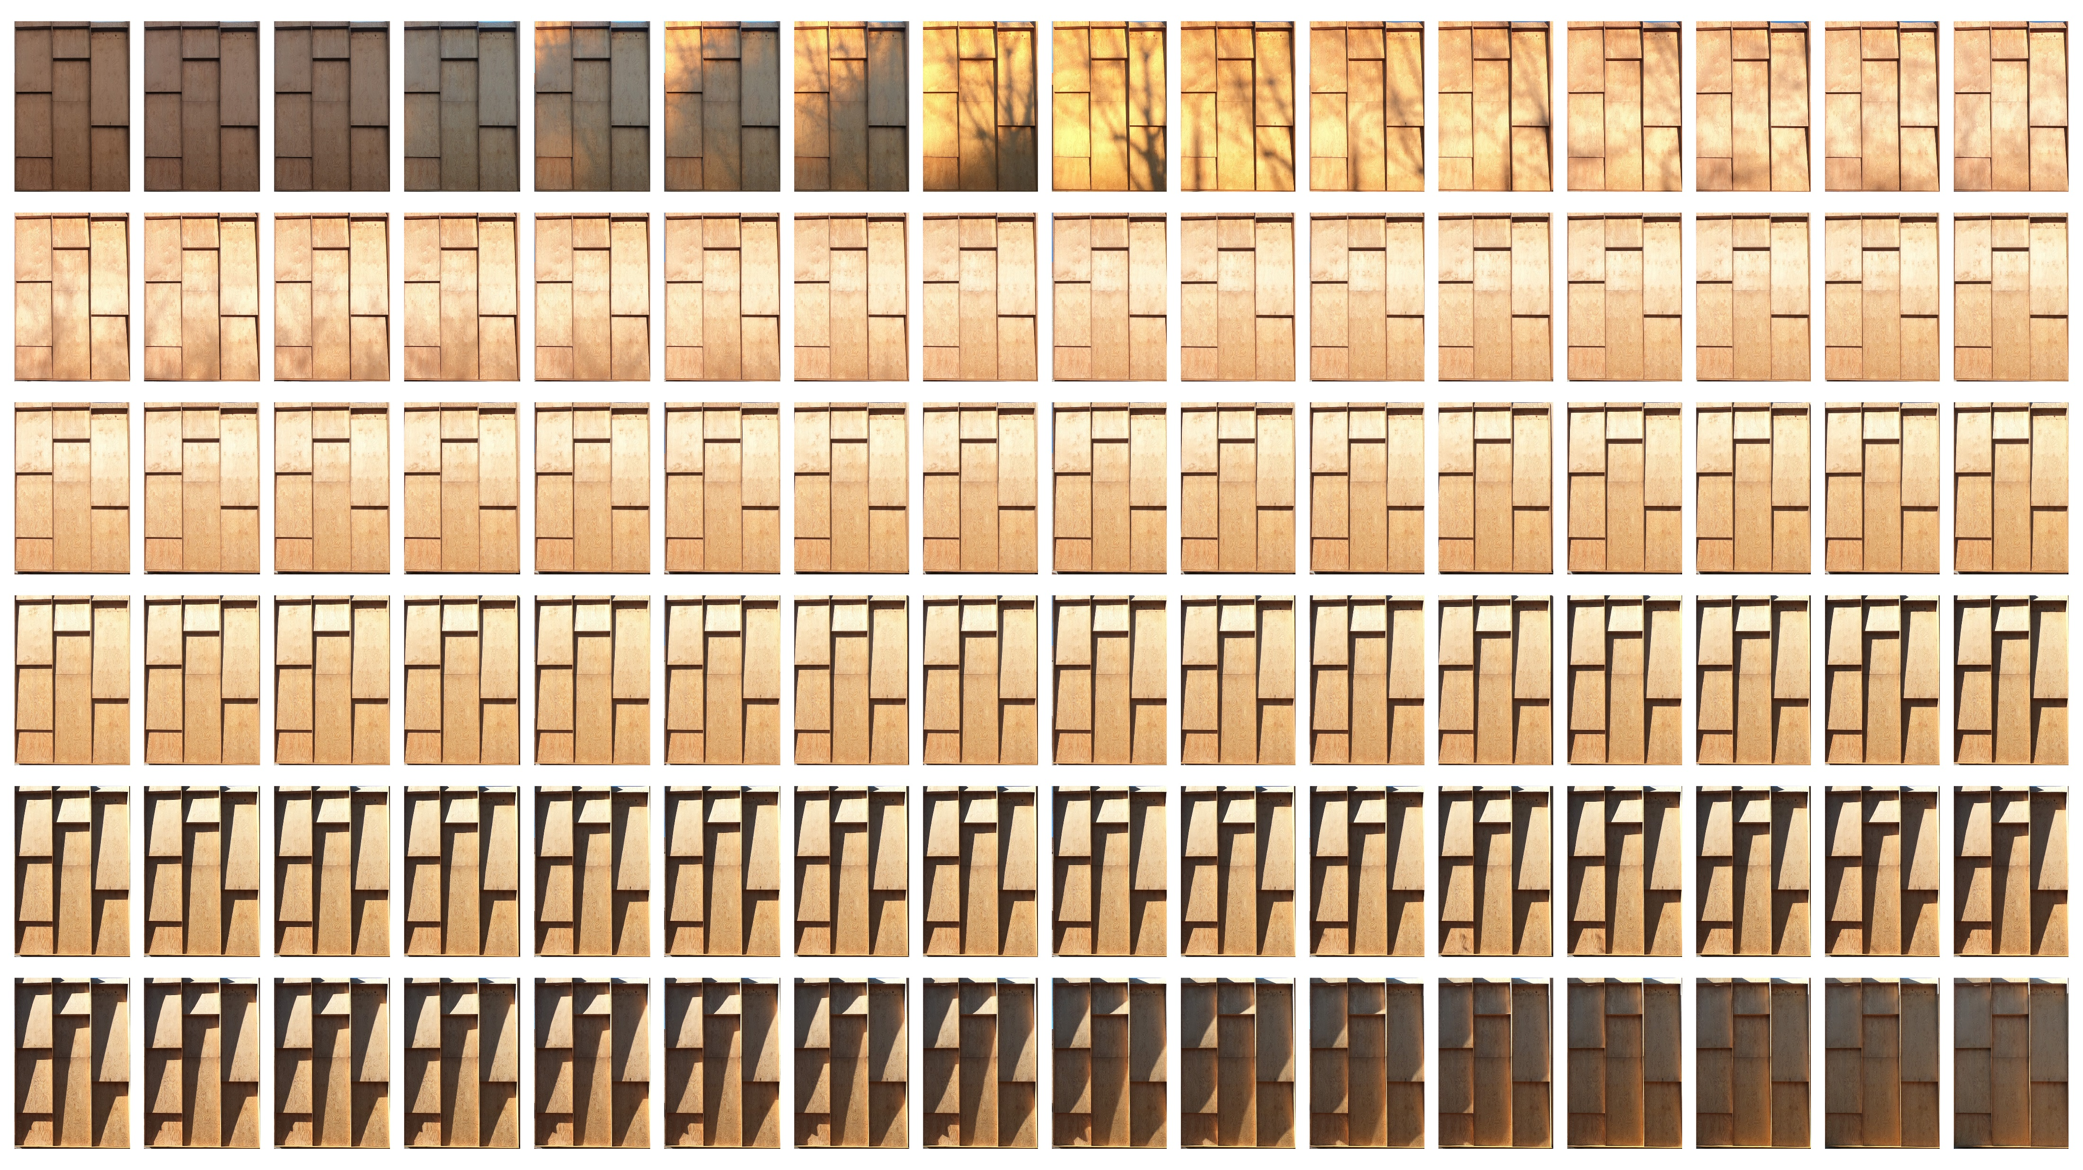
BUILDING FAÇADE LAYOUTS AND OPTIMIZATION
Final Project | 5002 Discrete Structures | Lipeipei Sun

Slide 2
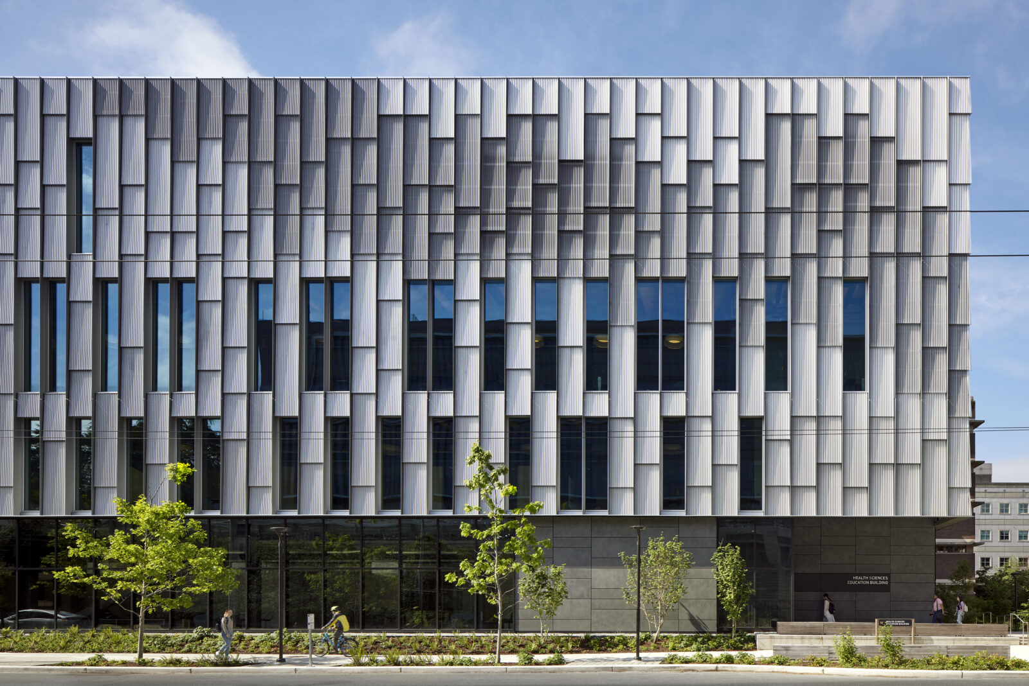
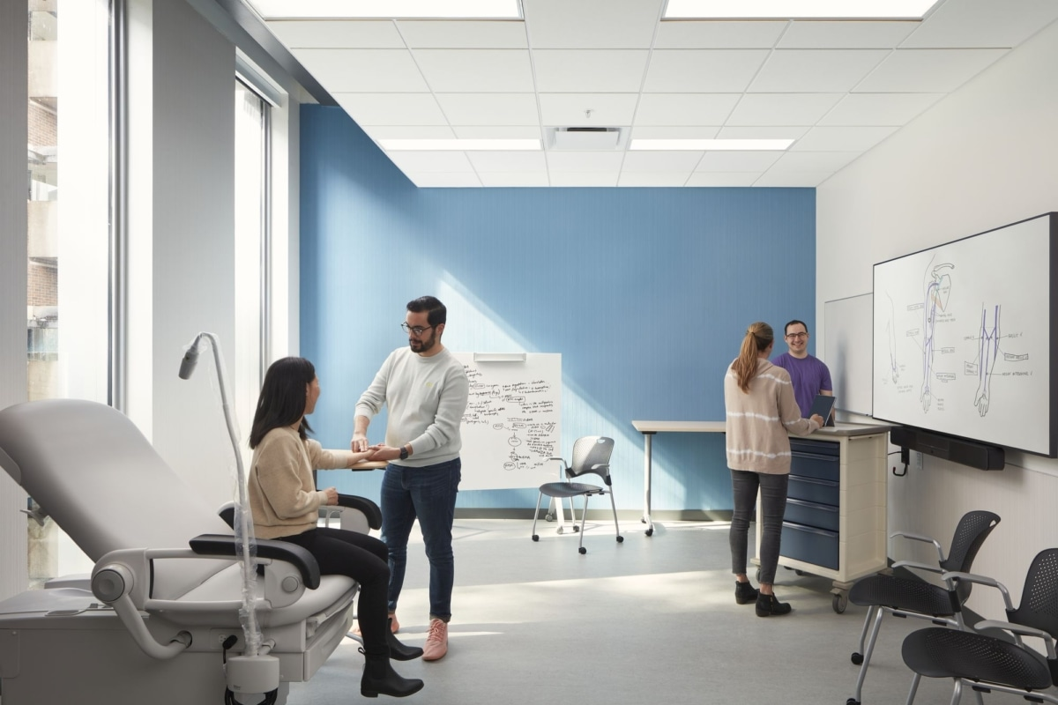
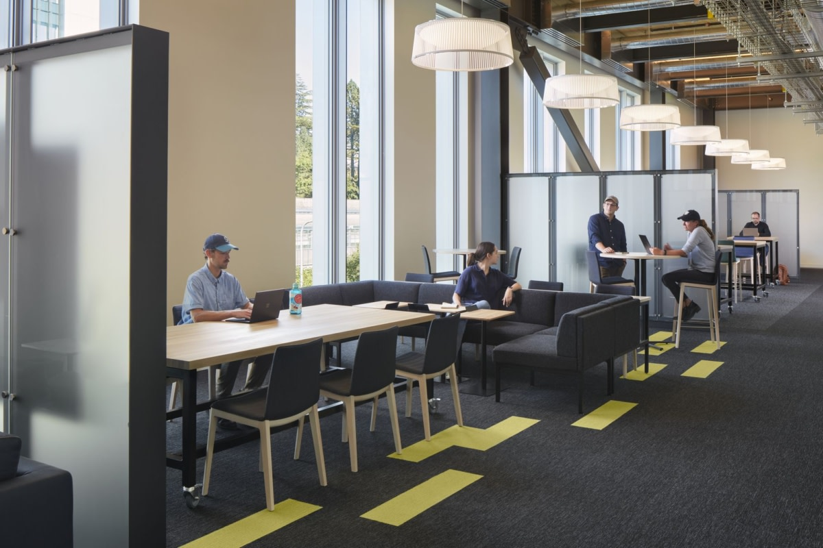

Slide 3
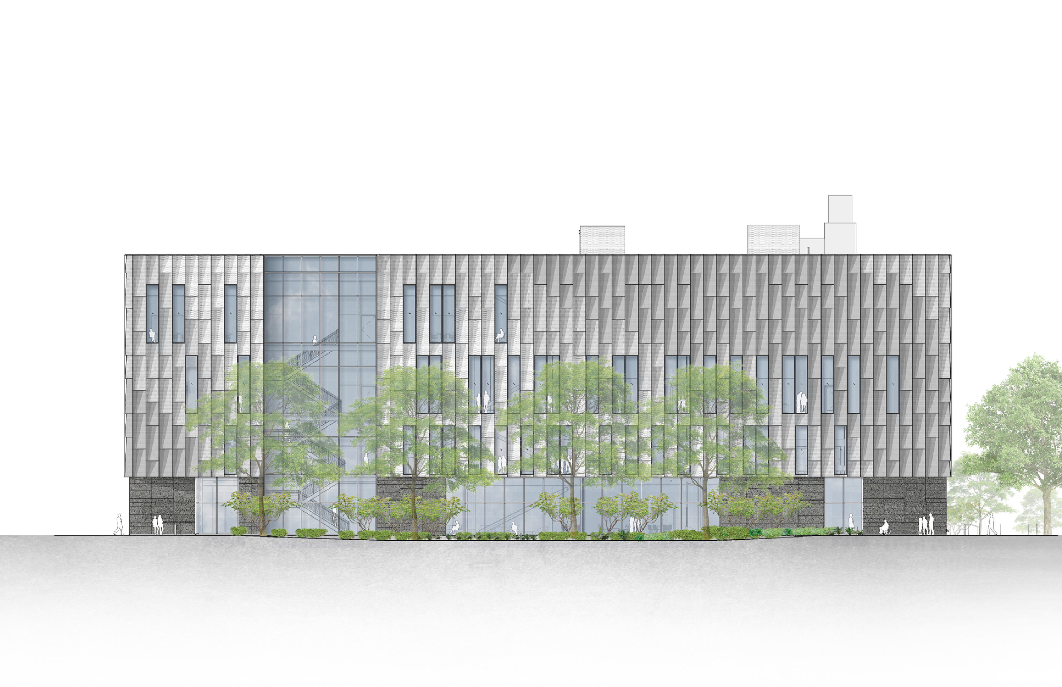
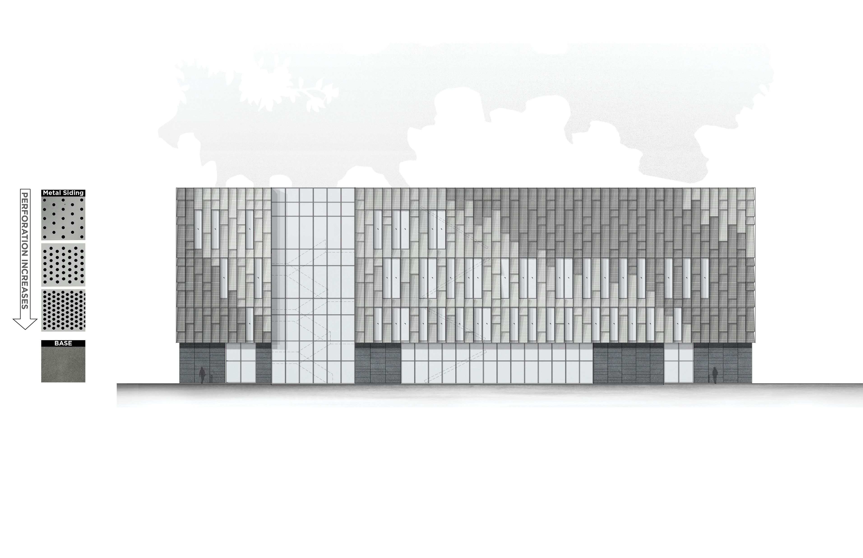

Slide 4
BASIC BUILDING FAÇADE REQUIREMENTS
140’
Building Facade Dimensions:
Width: 140 feet
Height: 54 feet
Building Stories:
Story height:
15 feet at Level 1
18 feet at Level 2 and 3
3 feet at parapet
Total stories: 3
Panel Sizes:
Heights: 3, 6, or 9 feet
Width: 40 inches (10/3 feet)
Window Specifications:
Height:
12 feet at Level 1
15 feet at Level 2 and 3.
Located at floor level with elevations:
0, 15, and 33 feet.
54’

Slide 5
BASIC BUILDING FAÇADE REQUIREMENTS
(40” X 42BAYS)
140’
Building Facade Dimensions:
Width: 140 feet
Height: 54 feet
Building Stories:
Story height:
15 feet at Level 1
18 feet at Level 2 and 3
3 feet at parapet
Total stories: 3
Panel Sizes:
Heights: 3, 6, or 9 feet
Width: 40 inches (10/3 feet)
Window Specifications:
Height:
12 feet at Level 1
15 feet at Level 2 and 3.
Located at floor level with elevations:
0, 15, and 33 feet.
3’
18’
54’
18’
15’

Slide 6
BASIC BUILDING FAÇADE REQUIREMENTS
(40” X 42BAYS)
140’
Building Facade Dimensions:
Width: 140 feet
Height: 54 feet
Building Stories:
Story height:
15 feet at Level 1
18 feet at Level 2 and 3
3 feet at parapet
Total stories: 3
Panel Sizes:
Heights: 3, 6, or 9 feet
Width: 40 inches (10/3 feet)
Window Specifications:
Height:
12 feet at Level 1
15 feet at Level 2 and 3.
Located at floor level with elevations:
0, 15, and 33 feet
3’
18’
54’
18’
15’

Slide 7
BASIC BUILDING FAÇADE REQUIREMENTS
(40” X 42BAYS)
140’
Building Facade Dimensions:
Width: 140 feet
Height: 54 feet
Building Stories:
Story height:
15 feet at Level 1
18 feet at Level 2 and 3
3 feet at parapet
Total stories: 3
Panel Sizes:
Heights: 3, 6, or 9 feet
Width: 40 inches (10/3 feet)
Window Specifications:
Height:
12 feet at Level 1
15 feet at Level 2 and 3.
Located at floor level with elevations:
0, 15, and 33 feet
3’
18’
15’
EL33
54’
18’
15’
EL15
15’
12’
EL0

Slide 8
PERFORMANCE REQUIREMENTS
The total glazing (window area) should be between 35% to 40% of the total facade area for each level.
Glazing area / Total area
Windows to be evenly distributed.

Slide 9
AESTHETIC PREFERENCES
Preference for 6 feet and 9 feet panels.
The 3 feet panel should be used between two windows.
No more than two windows should be adjacent to each other to maintain the building's aesthetic integrity.
9’ panel
6’ panel
3’ panel

Slide 10
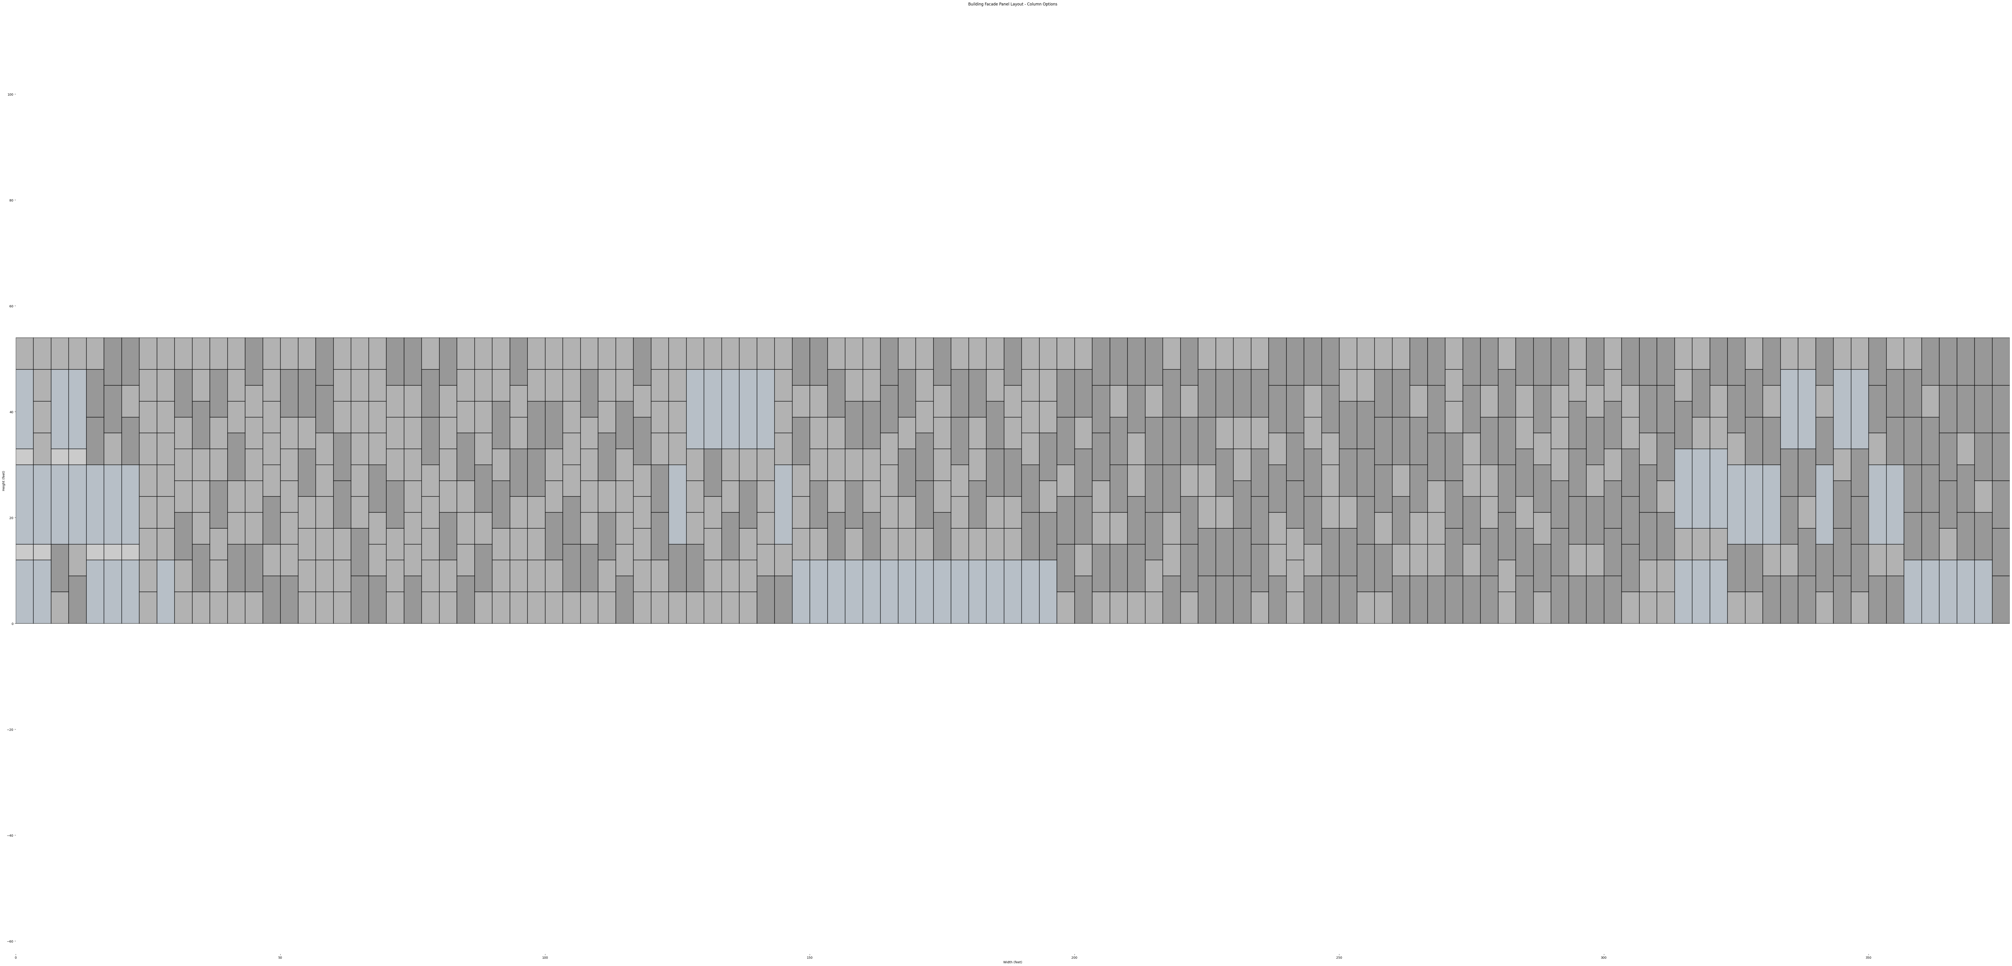
PROCESS
STEP 1.
Find all valid options for the vertical bays
STEP 2.
Rearrange the vertical bays on building façade based on the requirements
140’
(40” X 42 BAYS)
54’

Slide 11
OTPIONS FOR VERTICAL BAYS
Combinations based on
3’, 6’, 9’ solid panels
12’ and 15’ windows
BUILDING HEIGHT
(54 FOOT MAX)
141 OPTIONS
(REPRESENTED AT 40” WIDE PER BAY)

Slide 12
NARROW DOWN THE OPTIONS
Eliminate invalid options
Max two 3’ panel unless there is a window
Max one 12’ tall window and two 15’ tall window
BUILDING HEIGHT
(54 FOOT MAX)
141 OPTIONS
(REPRESENTED AT 40” WIDE PER BAY)

Slide 13
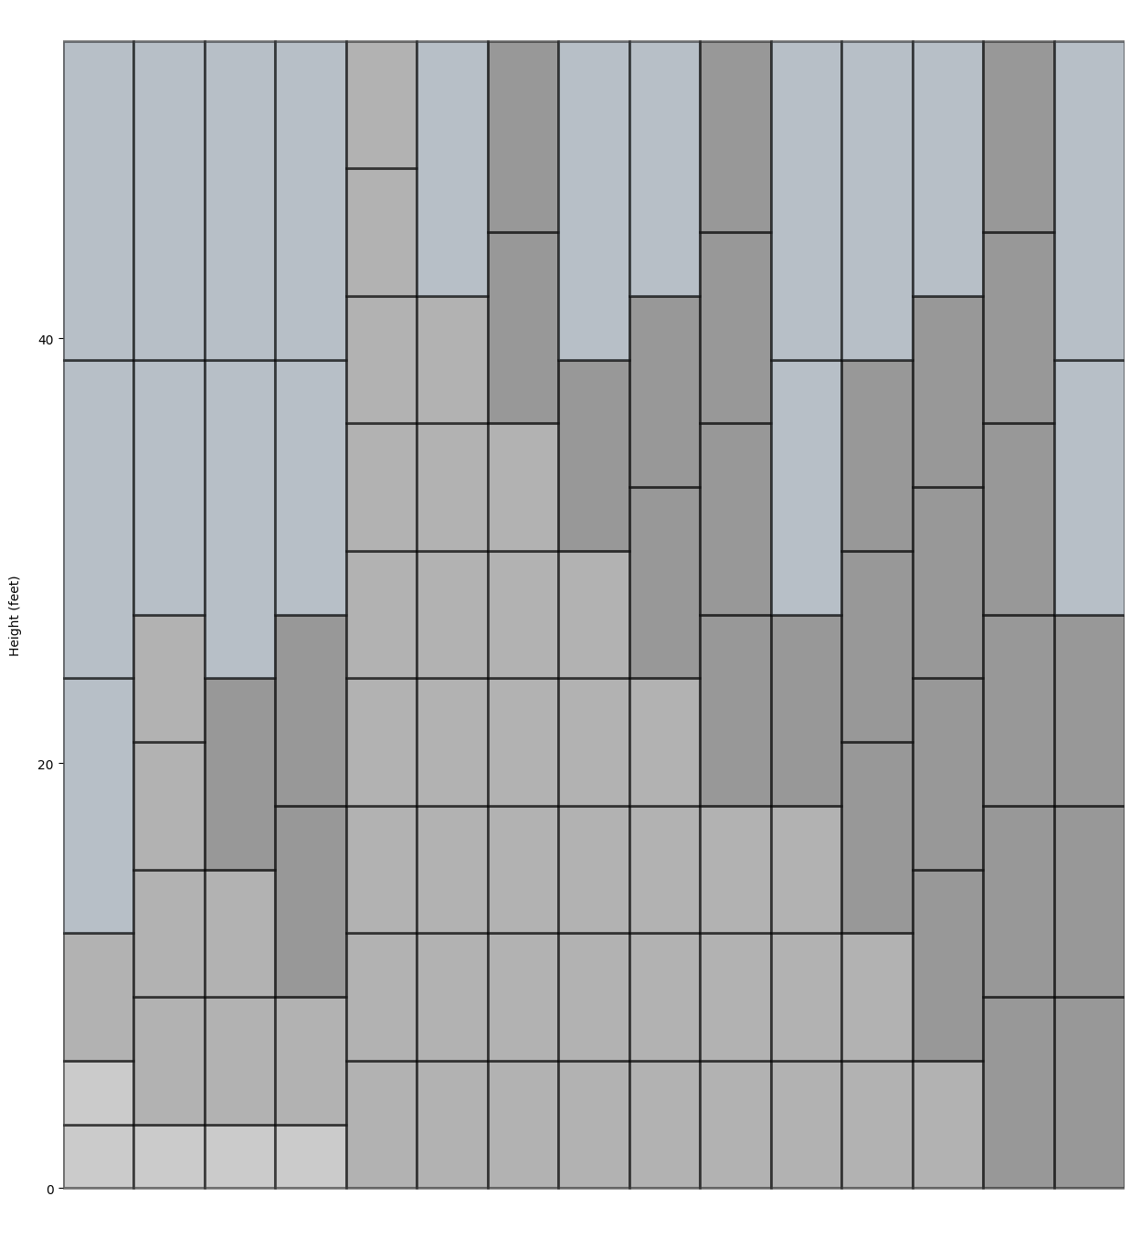
NARROW DOWN THE OPTIONS
Eliminate invalid options
Max two 3’ panel unless there is a window
Max one 12’ tall window and two 15’ tall window
BUILDING HEIGHT
(54 FOOT MAX)
BUILDING HEIGHT
(54 FOOT MAX)
141 OPTIONS
15 OPTIONS

Slide 14
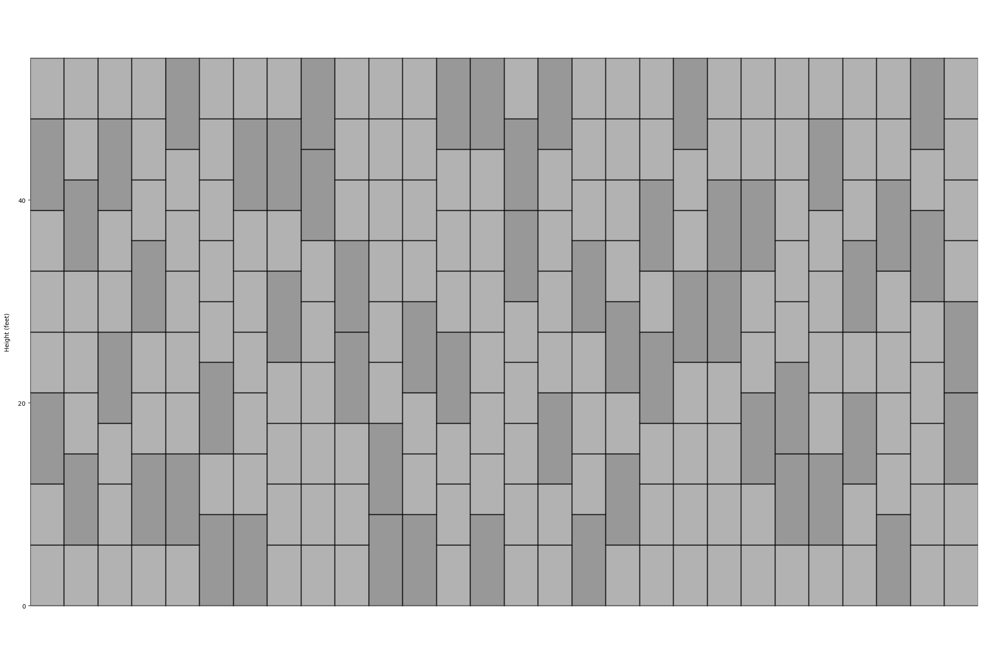
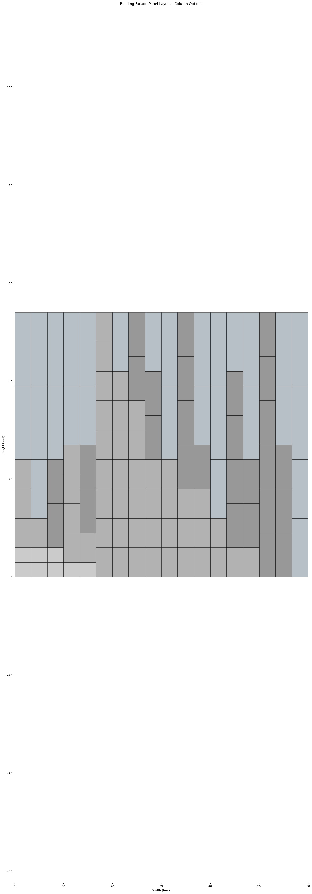
Permutations
Get valid and unique panel arrangements
BUILDING HEIGHT
(54 FOOT MAX)
28 WAYS TO ARRANGE
THE PANELS
15 OPTIONS
PANEL TYPES

Slide 15
Permutations
Get valid and unique panel arrangements
BUILDING HEIGHT
(54 FOOT MAX)
15’ window
12’ window
6!
2!
= 360
9’ panel
15 OPTIONS
6 PANEL TYPES
9’ panel
6’ panel
3’ panel

Slide 16
360 OPTIONS
6 PANEL TYPES

Slide 17
Permutations
Get valid and unique panel arrangements
Ensure windows are located at the correct height
BUILDING HEIGHT
(54 FOOT MAX)
15’
15 OPTIONS
EL15
6 PANEL TYPES
12’
3 WAYS TO
ARRANGE THE PANELS
EL0

Slide 18
Permutations
Get valid and unique panel arrangements
BUILDING HEIGHT
(54 FOOT MAX)
15 OPTIONS
113 OPTIONS

Slide 19
Permutation (113, 42)
113 valid options SELECT 42 vertical bays
(40” X 42 BAYS)
140’
54’

Slide 20
REQUIREMENTS
BASIC DIMENSIONS
PERFORMANCE
AESTHETIC
Building Facade Dimensions:
Width: 140 feet (42 Bays)
Height: 54 feet
Building Stories:
Story height:
15 feet at Level 1
18 feet at Level 2 and 3
3 feet at parapet
Total stories: 3
Panel Sizes:
Heights: 3, 6, or 9 feet
Width: 40 inches (10/3 feet)
Window Specifications:
Height:
12 feet at Level 1
15 feet at Level 2 and 3.
Located at floor level with elevations:
0, 15, and 33 feet
The total glazing (window area) should be between 35% to 40% of the total facade area for each level.
Windows to be evenly distributed.
Preference for 6 feet and 9 feet panels.
The 3 feet panel should be used between two windows.
No more than two windows should be adjacent to each other to maintain the building's aesthetic integrity.

Slide 21
REQUIREMENTS
BASIC DIMENSIONS
PERFORMANCE
AESTHETIC
Building Facade Dimensions:
Width: 140 feet (42 Bays)
Height: 54 feet
Building Stories:
Story height:
15 feet at Level 1
18 feet at Level 2 and 3
3 feet at parapet
Total stories: 3
Panel Sizes:
Heights: 3, 6, or 9 feet
Width: 40 inches (10/3 feet)
Window Specifications:
Height:
12 feet at Level 1
15 feet at Level 2 and 3.
Located at floor level with elevations:
0, 15, and 33 feet
The total glazing (window area) should be between 35% to 40% of the total facade area for each level.
Windows to be evenly distributed.
Preference for 6 feet and 9 feet panels.
The 3 feet panel should be used between two windows.
No more than two windows should be adjacent to each other to maintain the building's aesthetic integrity.

Slide 22
113 select 42 with repetitions
=
113^42
113 select 42 without repetitions
=
113! / (113-42)!

Slide 23
REQUIREMENTS
BASIC DIMENSIONS
PERFORMANCE
AESTHETIC
Building Facade Dimensions:
Width: 140 feet (42 Bays)
The total glazing (window area) should be between 35% to 40% of the total facade area for each level.
Windows to be evenly distributed.
No more than two windows should be adjacent to each other to maintain the building's aesthetic integrity.

Slide 24
METHOD 1 - Simplifying the Combination Analysis & Finding Patterns
(40” X 42 BAYS)
140’
54’

Slide 25
PERFORMANCE
Glazing area
Total area
= 35% - 40%
# of windows required
42 VERTICAL BAYS
882sf to 1008sf
2520sf
LEVEL 3
18 – 20 WINDOWS
882sf to 1008sf
2520sf
LEVEL 2
18 – 20 WINDOWS
735sf to 840sf
2100sf
LEVEL 1
19 - 21 WINDOWS

Slide 26
PERFORMANCE
42 VERTICAL BAYS
LEVEL 3
18 – 20 WINDOWS
3 OPTIONS
LEVEL 2
18 – 20 WINDOWS
3 OPTIONS
LEVEL 1
19 - 21 WINDOWS
3 OPTIONS
TOTAL
3X3X3 = 27 OPTIONS

Slide 27
PERFORMANCE
BEST DAYLIGHT OPTION OUT OF THE 27 TOTAL OPTIONS
42 VERTICAL BAYS
LEVEL 3
20 WINDOWS
18 – 20 WINDOWS
LEVEL 2
20 WINDOWS
18 – 20 WINDOWS
LEVEL 1
21 WINDOWS
19 - 21 WINDOWS

Slide 28
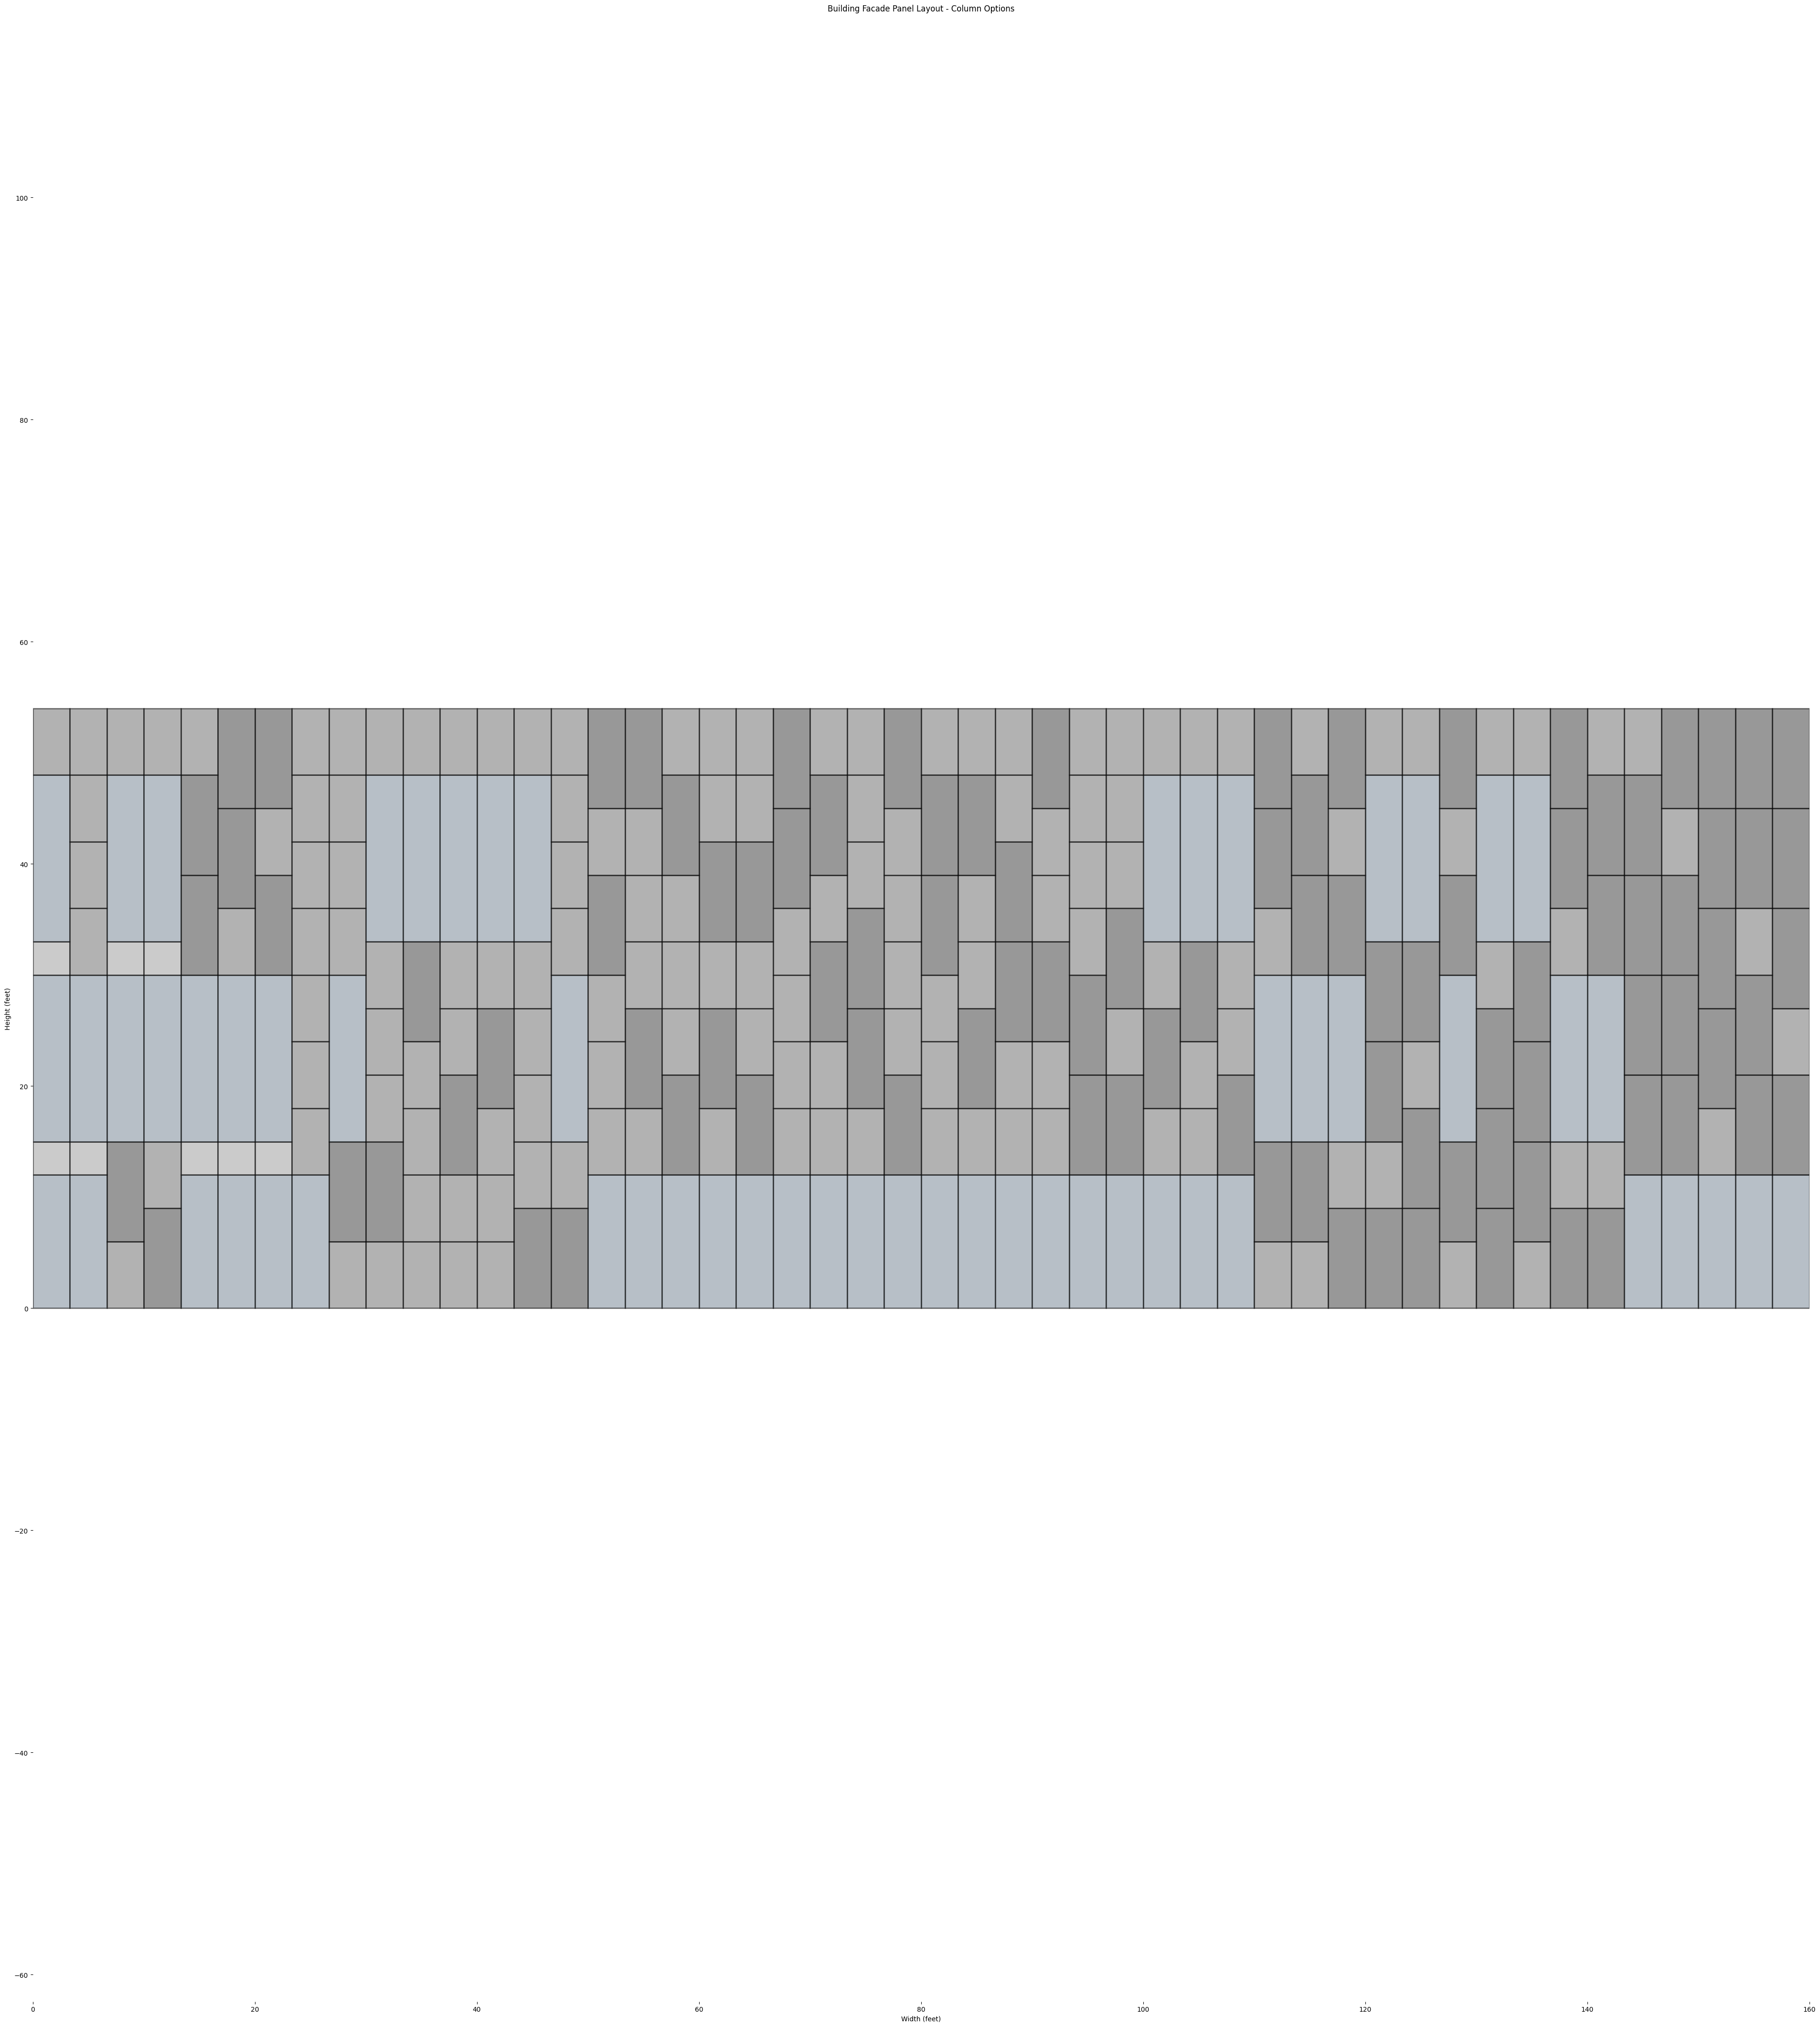
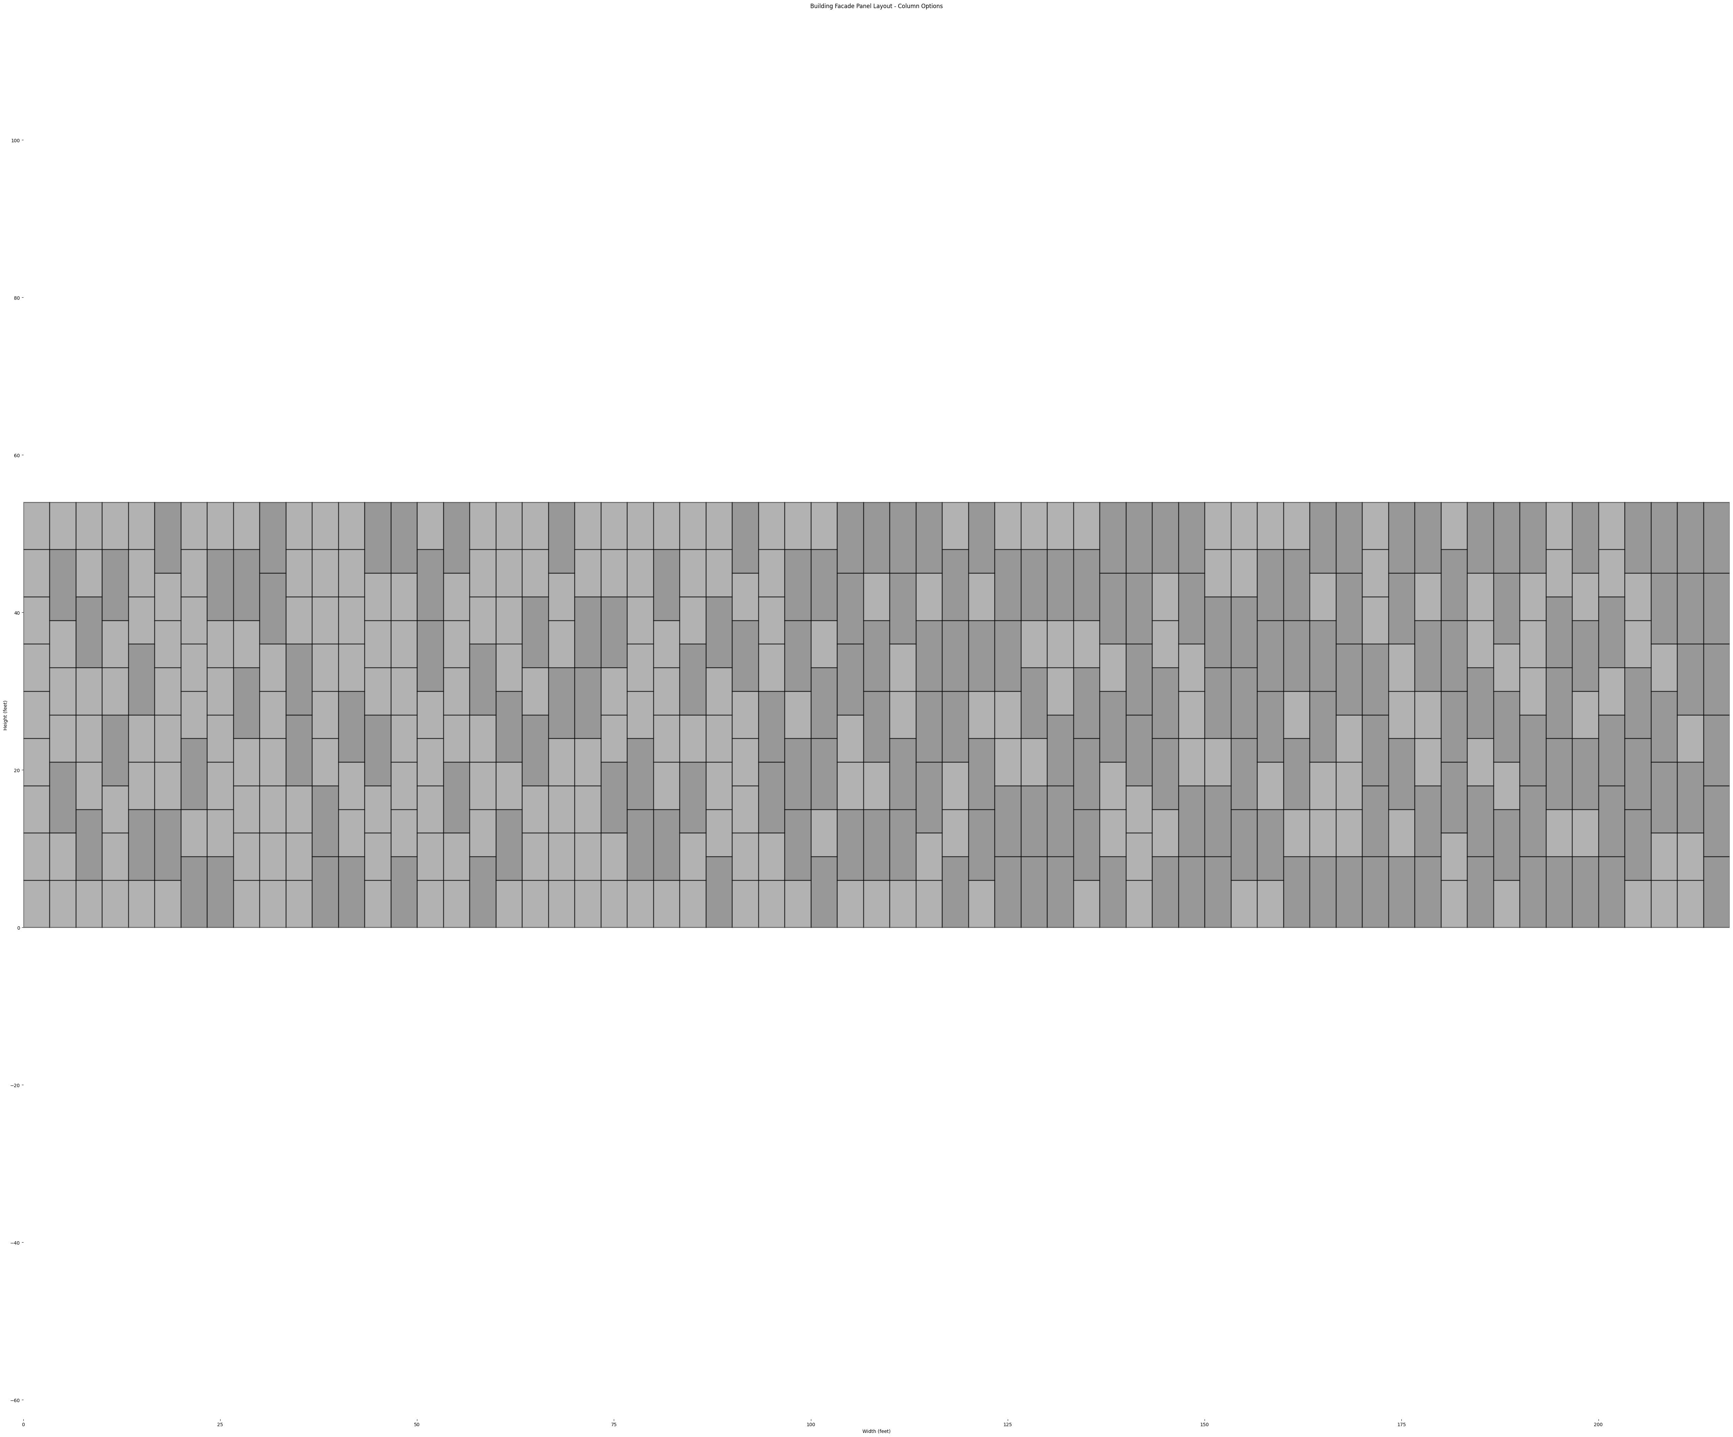
CATEGORIZE THE OPTIONS
OPTIONS WITH WINDOWS
OPTIONS WITHOUT WINDOWS

Slide 29
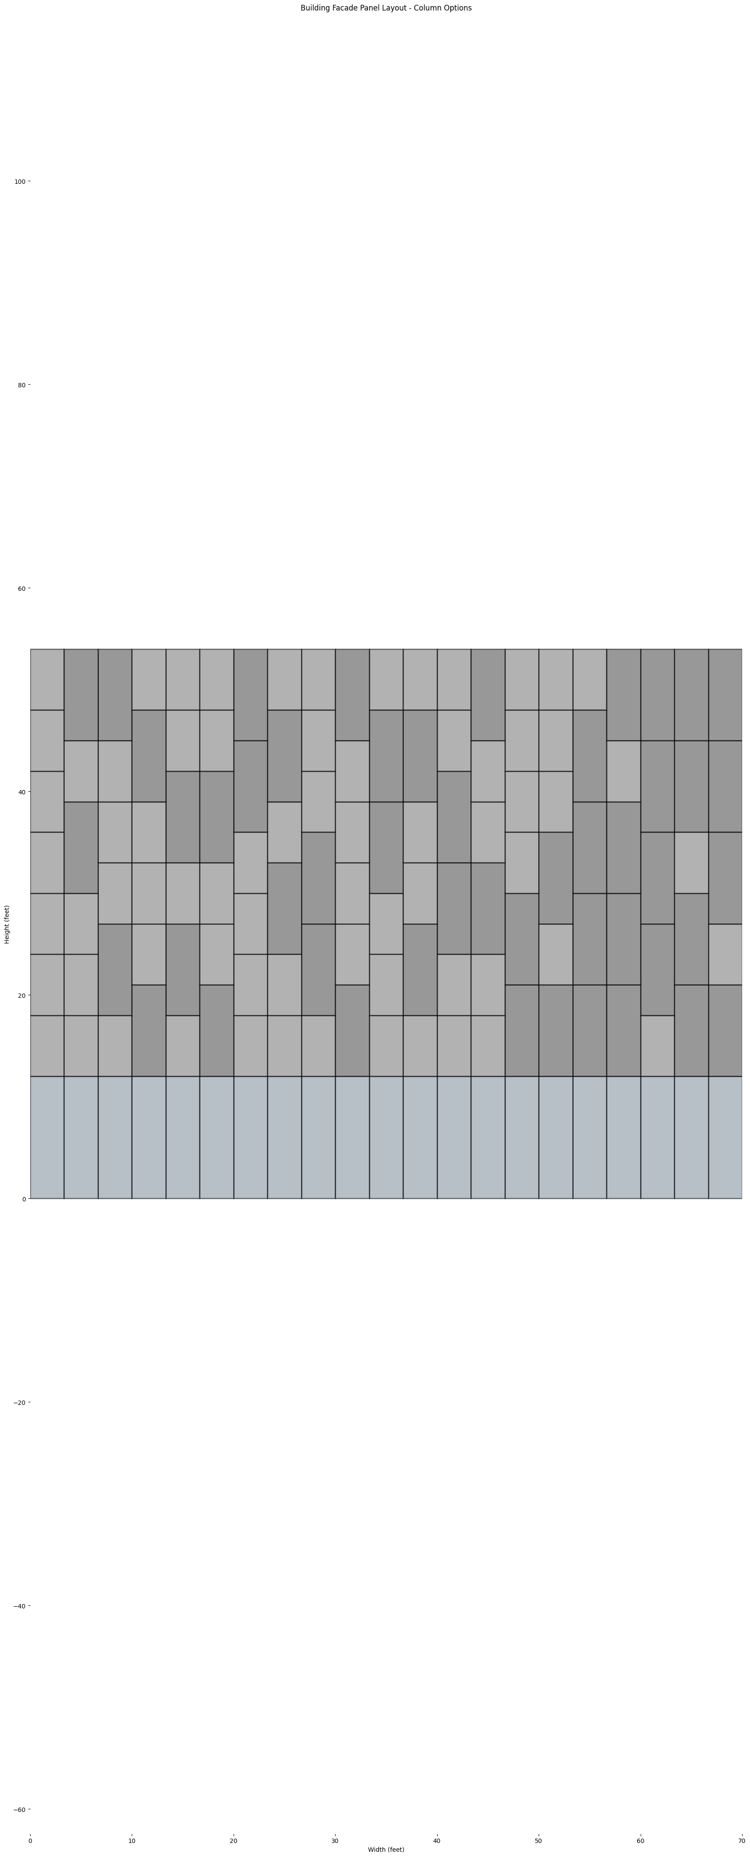
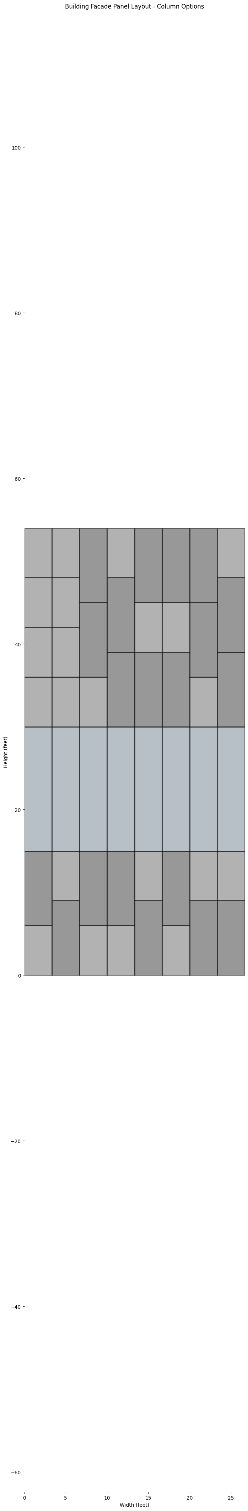
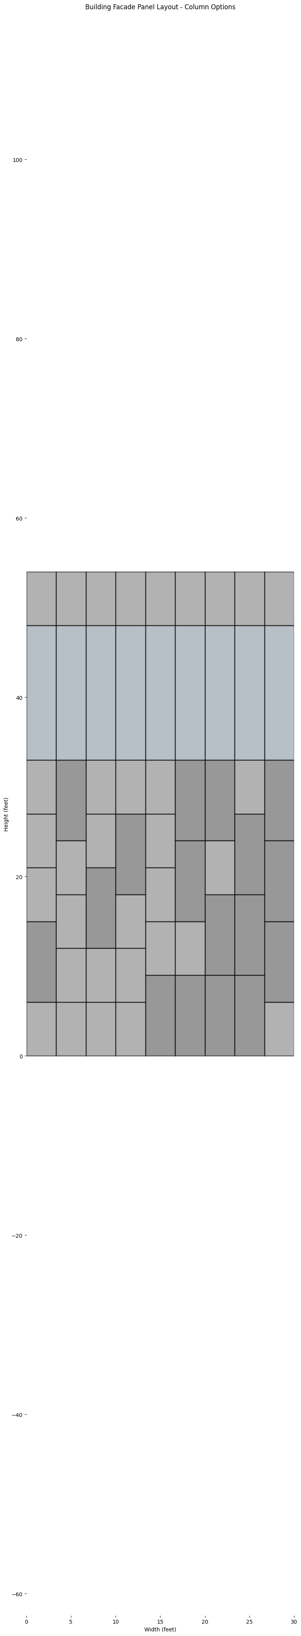
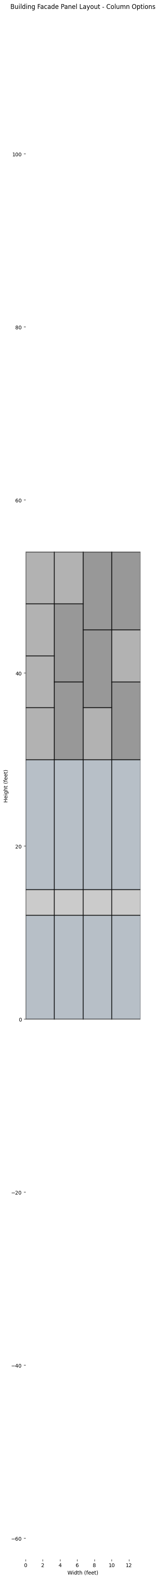
OPTIONS WITH WINDOWS
21 Options
8 Options
9 Options
4 Options
3 Options
2 Options
1 Option
Window At
Level 1 Only
Window At Level 2 Only
Window At Level 3 Only
Window At Level 1&2
Window At Level 1&3
Window At Level 2&3
Window At Level 1,2&3

Slide 30
OPTION A
21 Options
8 Options
9 Options
4 Options
3 Options
2 Options
1 Option
Window At Level 1 Only
Window At Level 2 Only
Window At Level 3 Only
Window At Level 1&2
Window At Level 1&3
Window At Level 2&3
Window At Level 1,2&3

Slide 31
OPTION A | Picking Window Bays
42 VERTICAL BAYS
LEVEL 3
20 WINDOWS
LEVEL 2
20 WINDOWS
LEVEL 1
21 WINDOWS
Pick 1 Out Of 21 Options
1 Option
Window At Level 1 Only
Window At Level 1,2&3

Slide 32
OPTION A | PICKING SOLID BAYS
42 VERTICAL BAYS
Without Repetition
C(65, 22) = 1.214554453 * 10^17
With Repetitions
P(65, 22) = 1.365160089 * 10^38
LEVEL 3
22 SOLID
20 WINDOWS
LEVEL 2
22 SOLID
20 WINDOWS
LEVEL 1
21 SOLID
21 WINDOWS
Pick 22 Out Of 65 Solid Options

Slide 33
OPTION A – Alternating between window bay and solid bay
21 bays with solid panels
Choosing 21 out of 1.214554453 * 10^17 or 1.365160089 * 10^38
20 bays with windows at all levels
Choosing 1 out 1
4
8
12
16
20
24
28
32
36
40

Slide 34
OPTION A – Alternating between window bay and solid bay
21 bays with solid panels
Choosing 21 out of 1.214554453 * 10^17 or 1.365160089 * 10^38
20 bays with windows at all levels
Choosing 1 out 1
1 bay with window at Level 1
42 ways to add the one window bay
random.choice
+
4
8
12
16
20
24
28
32
36
40

Slide 35
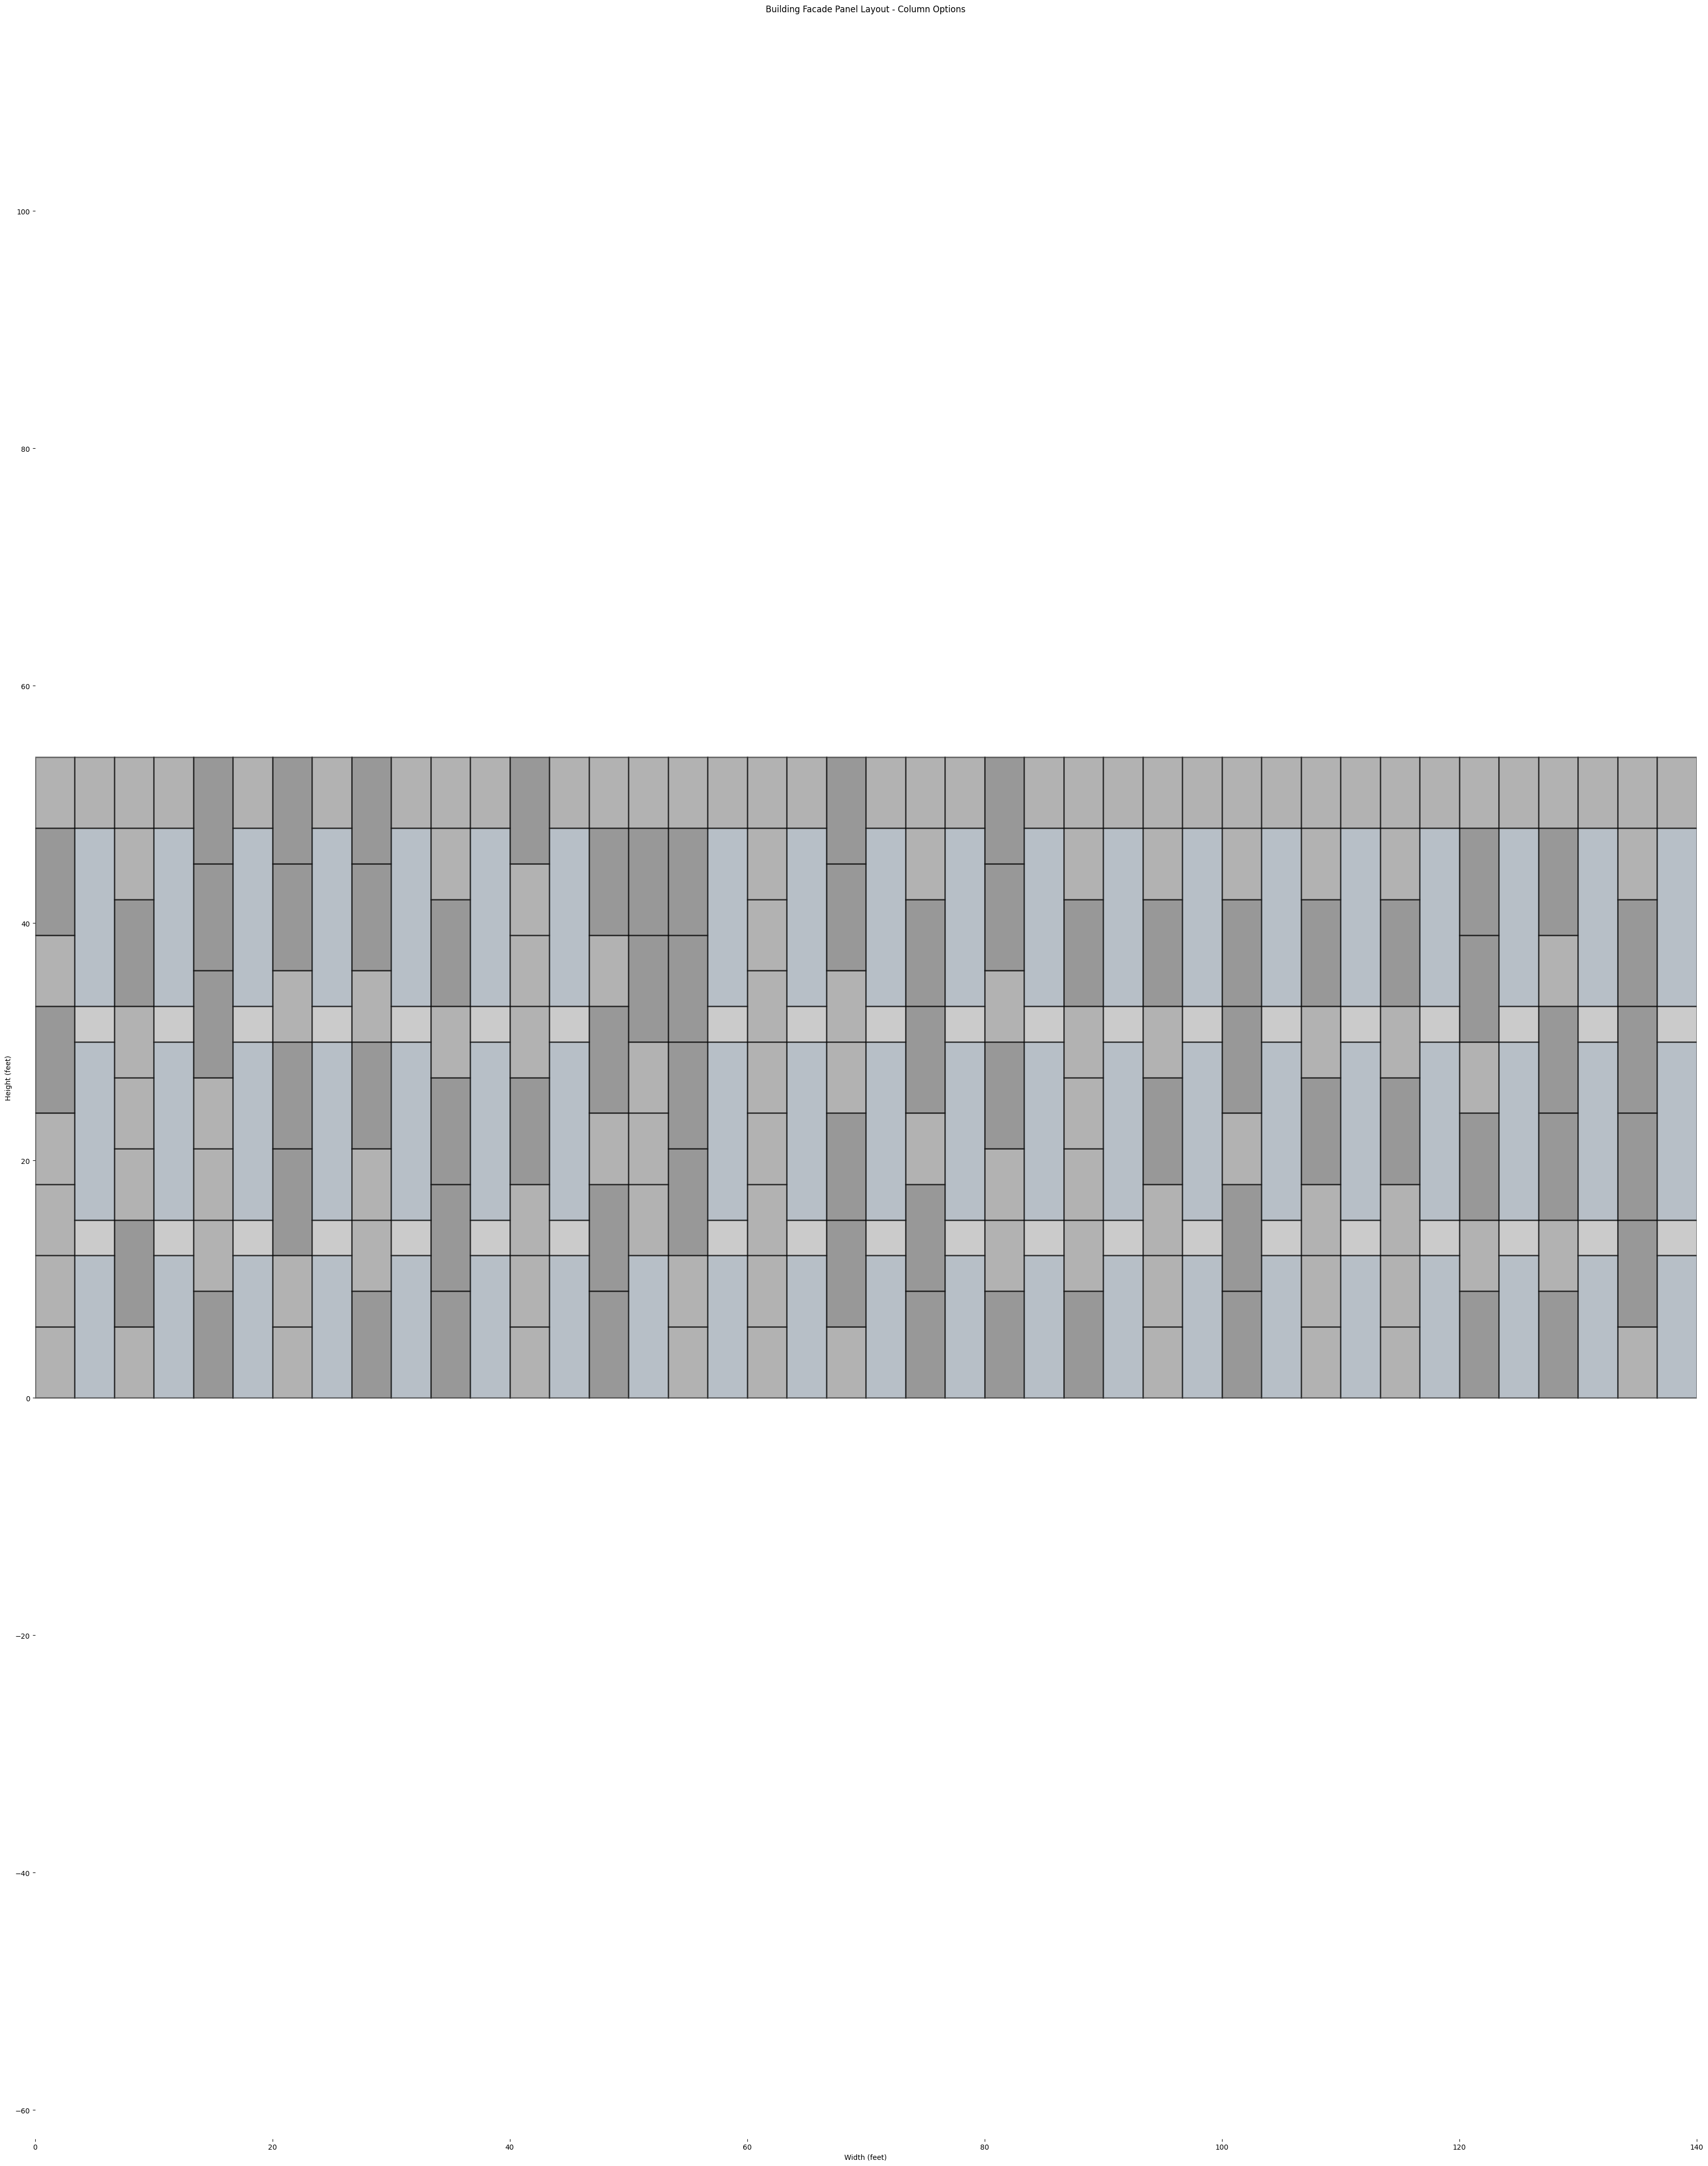
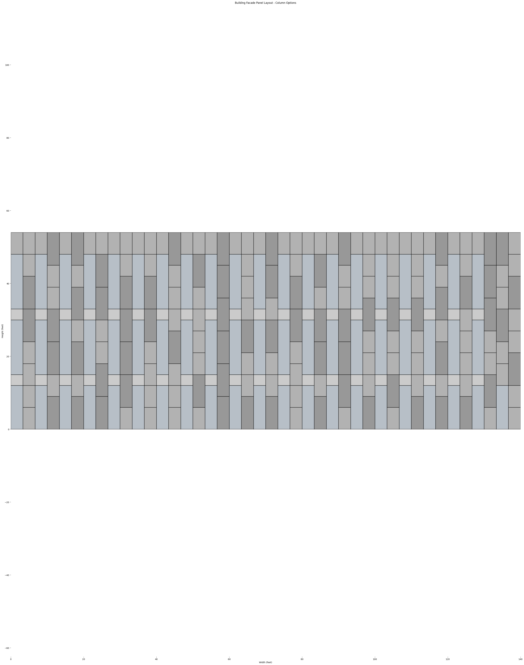
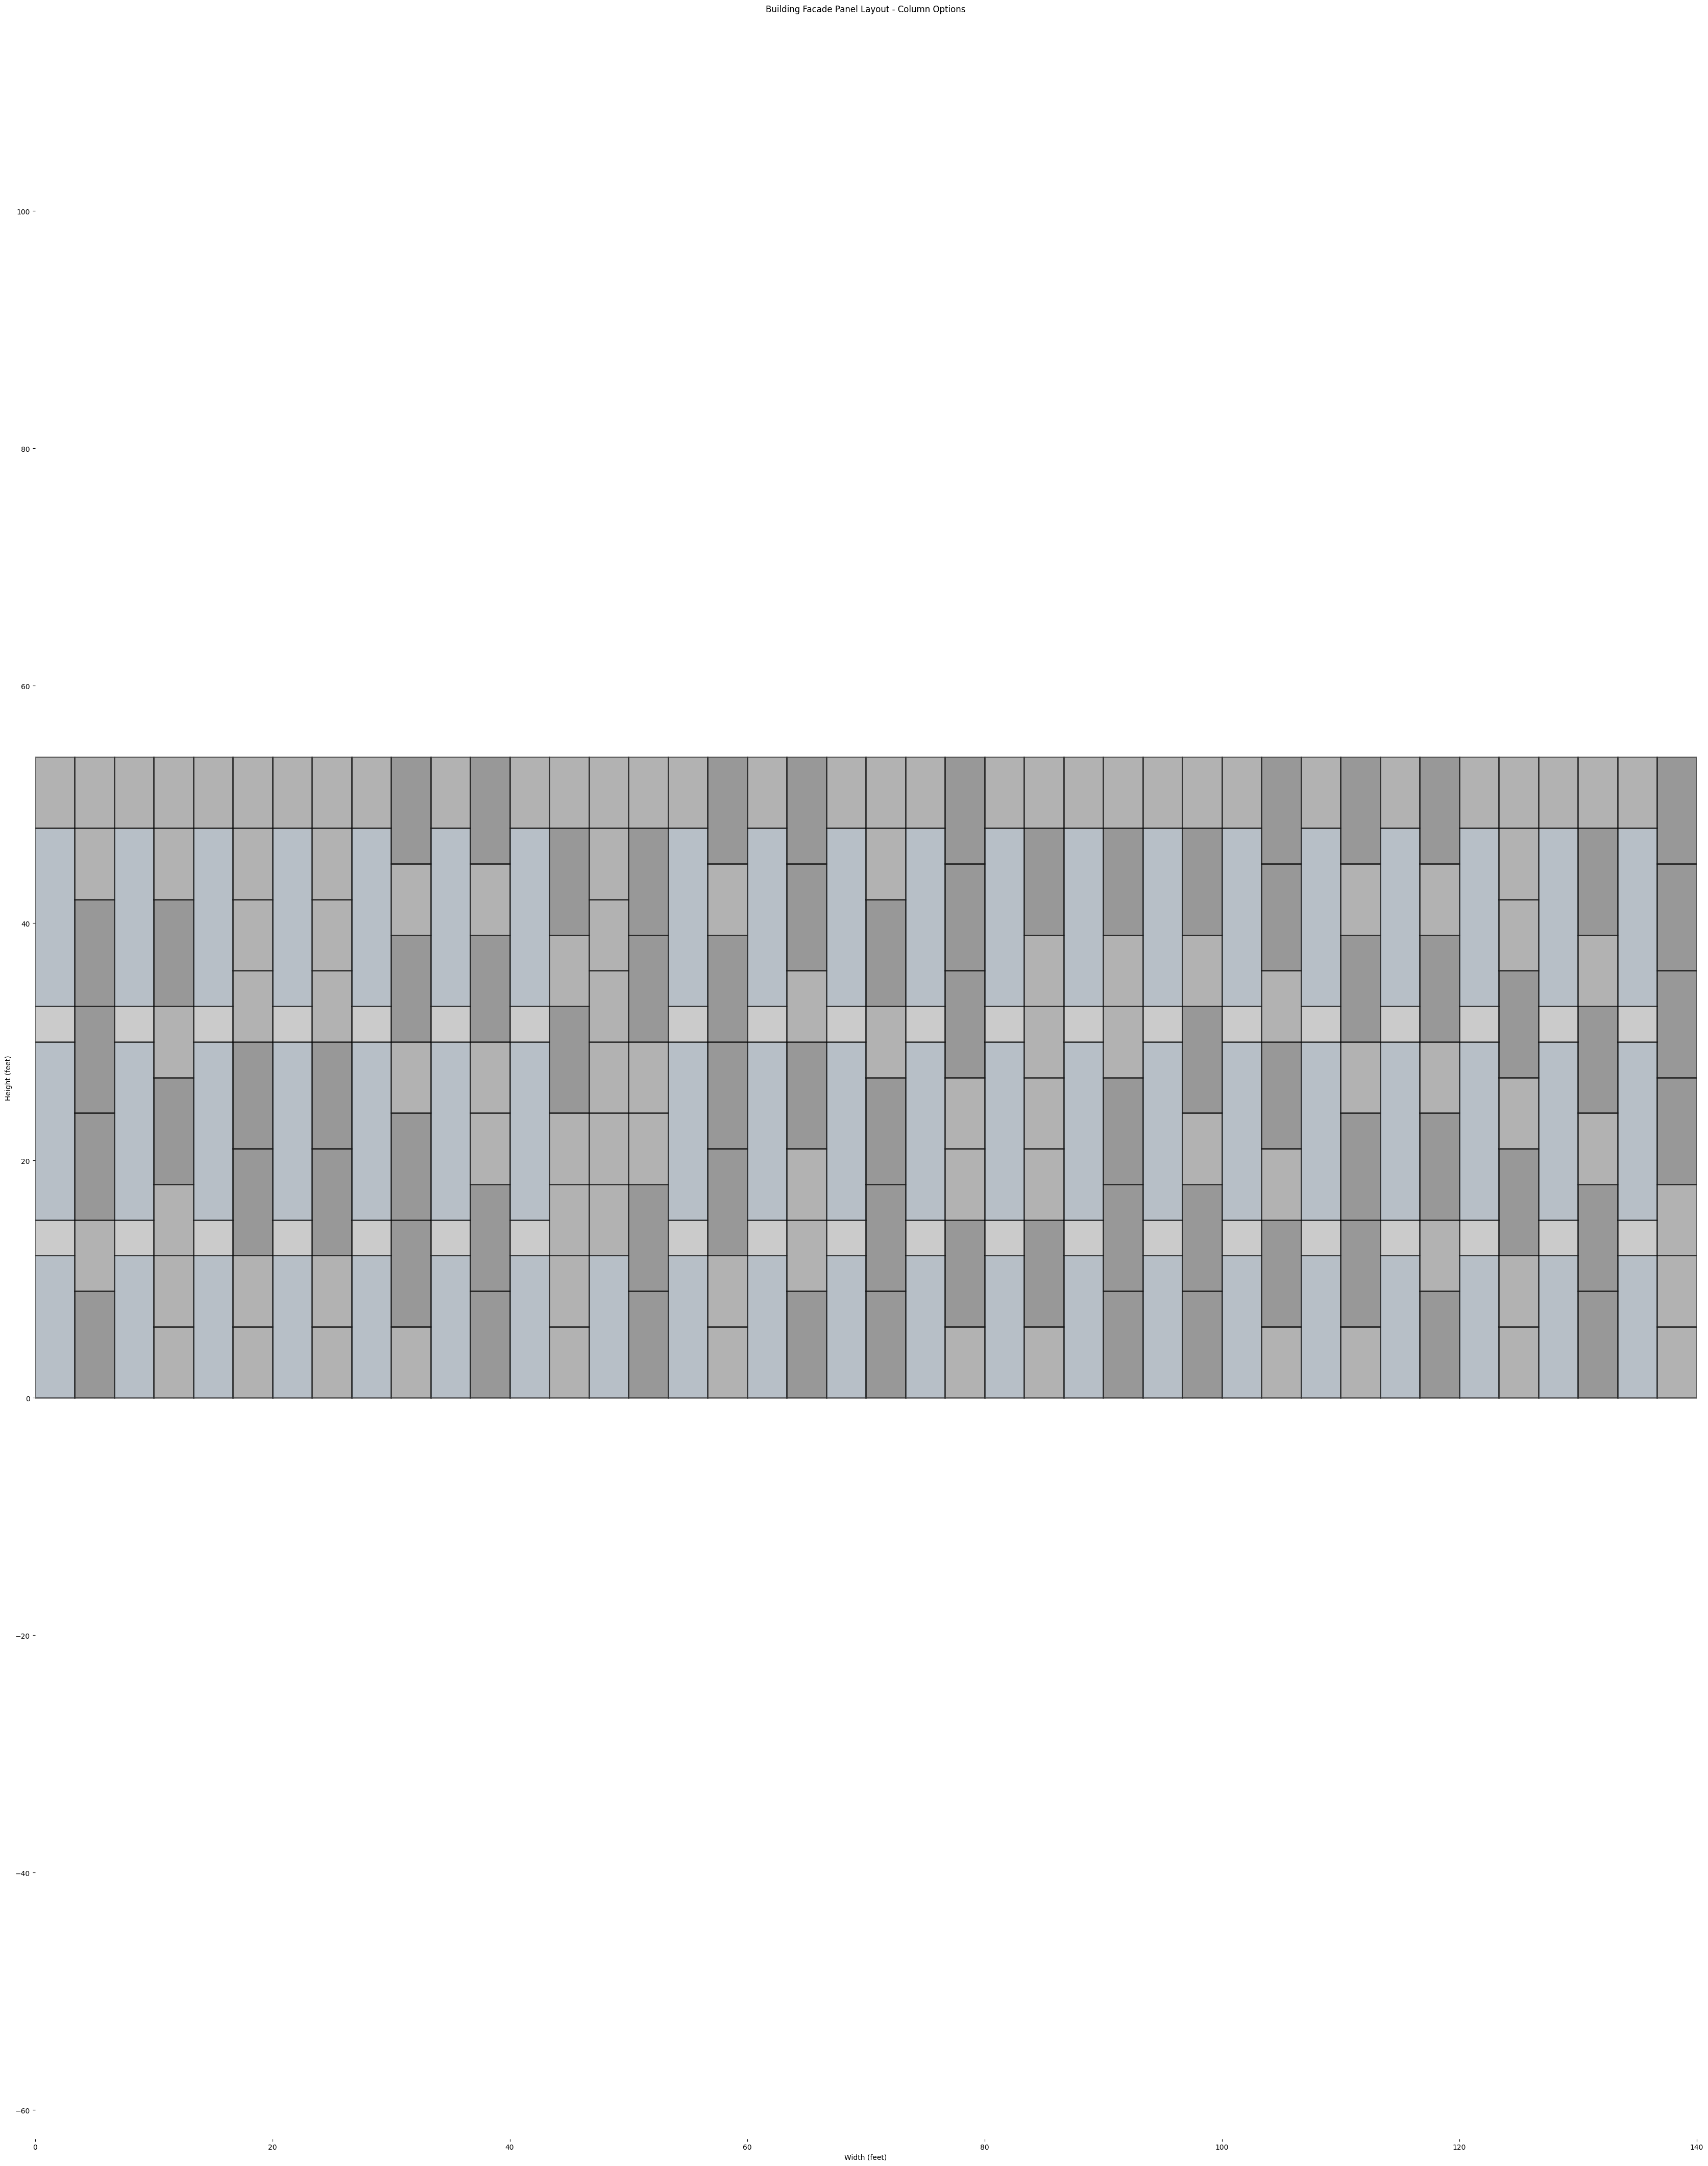
OPTION A

Slide 36
OPTION B
21 Options
8 Options
9 Options
4 Options
3 Options
2 Options
1 Options
Window At Level 1 Only
Window At Level 2 Only
Window At Level 3 Only
Window At Level 1&2
Window At Level 1&3
Window At Level 2&3
Window At Level 1,2&3

Slide 37
OPTION B
42 VERTICAL BAYS
LEVEL 3
20 WINDOWS
LEVEL 2
20 WINDOWS
LEVEL 1
21 WINDOWS
Pick 1 Out Of 21 Options
Pick 20
Pick 20
1
Window At Level 1 Only
Window At Level 2 Only
Window At Level 1&3

Slide 38
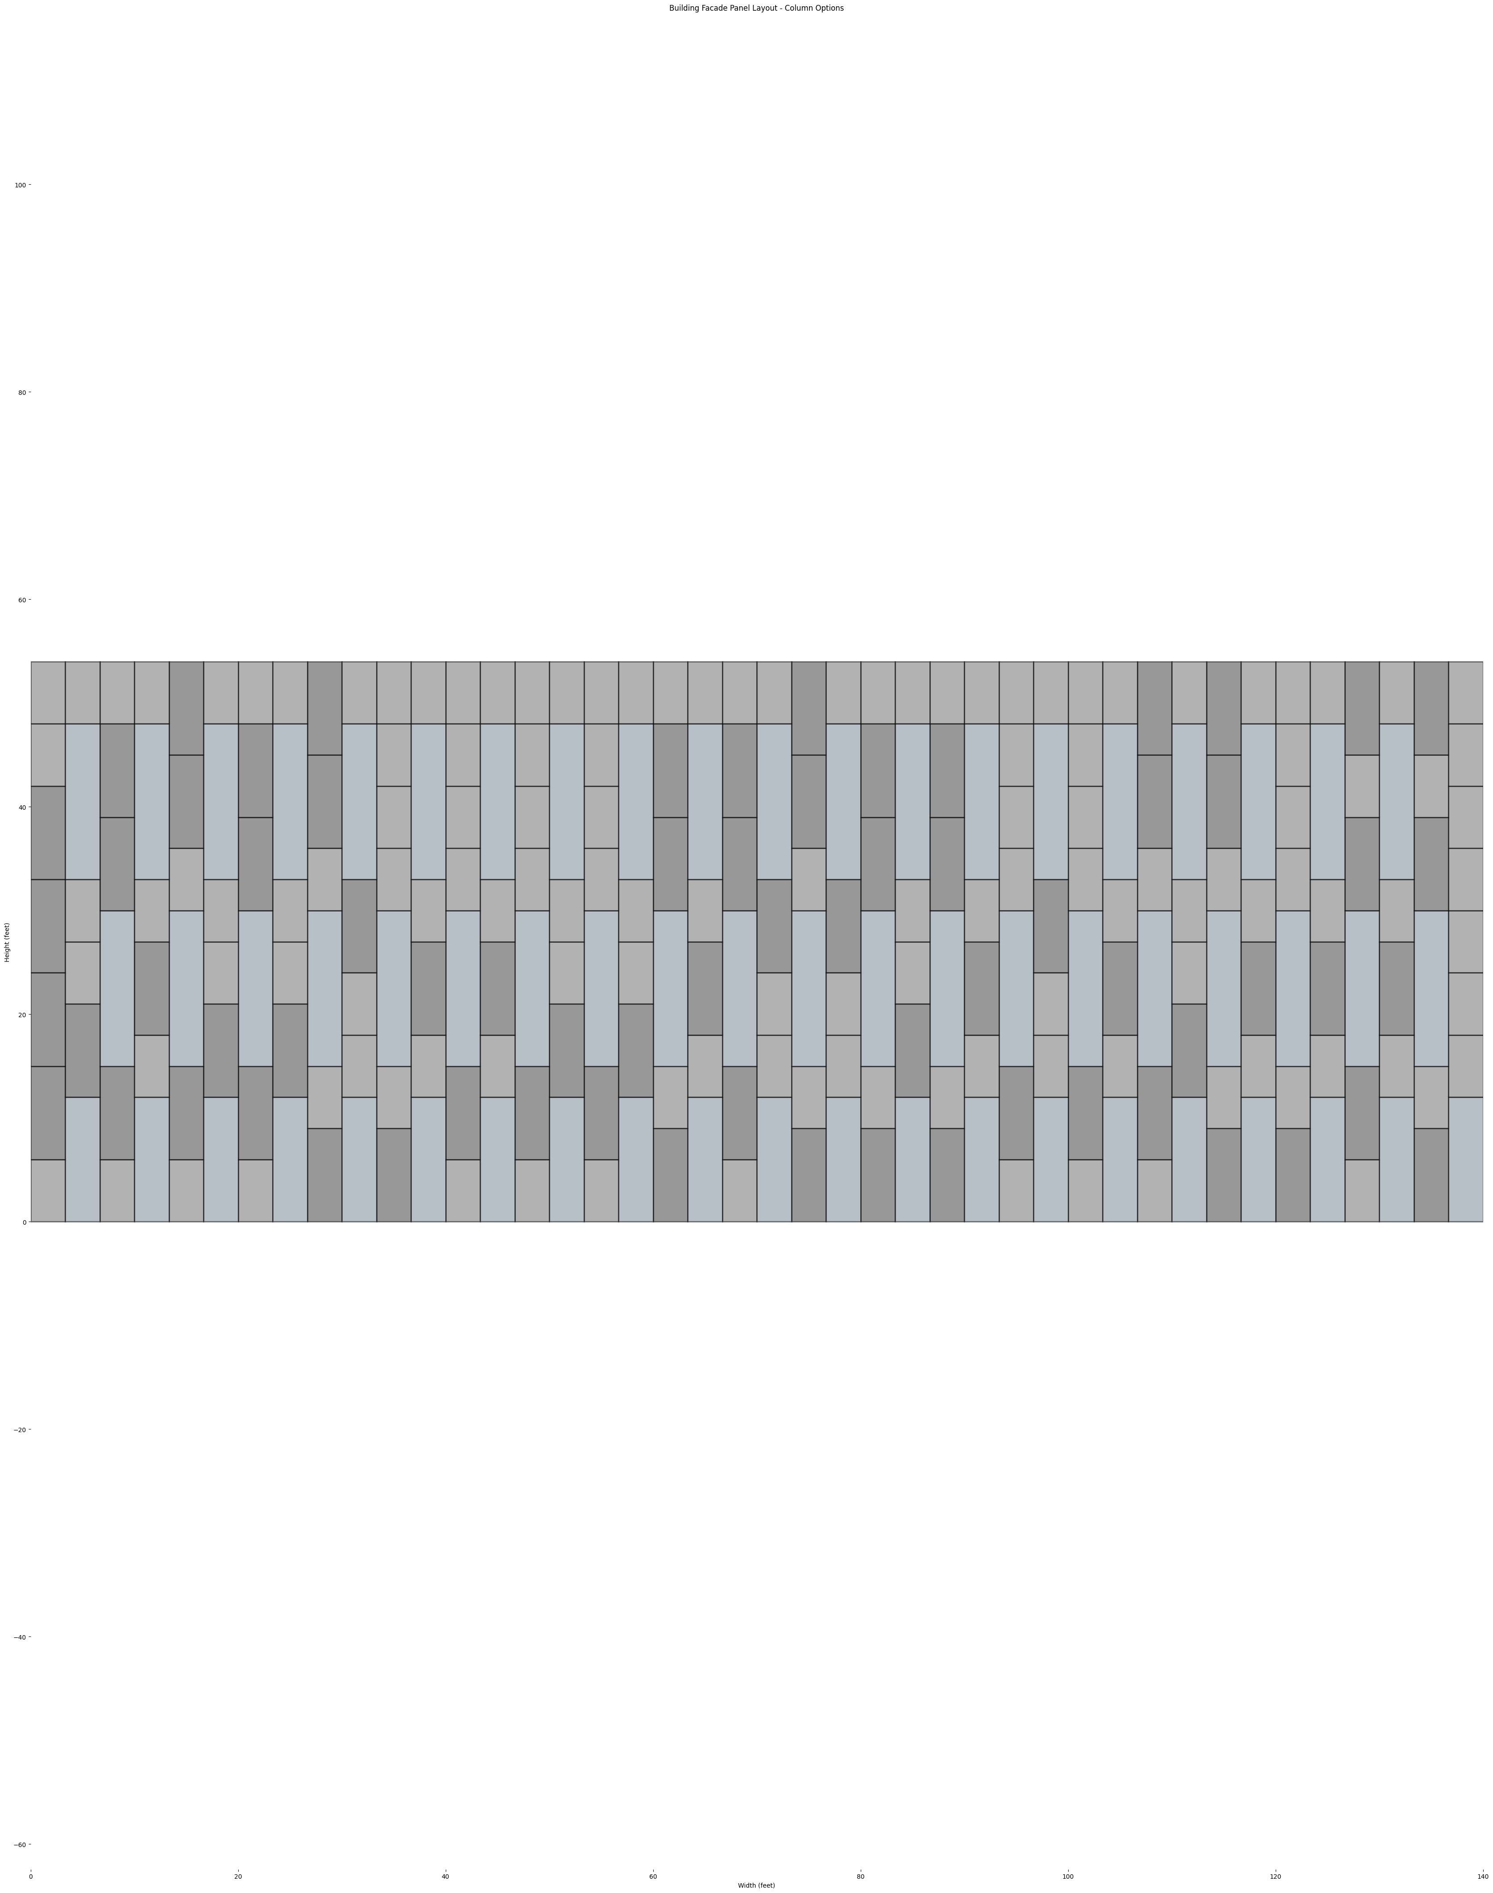
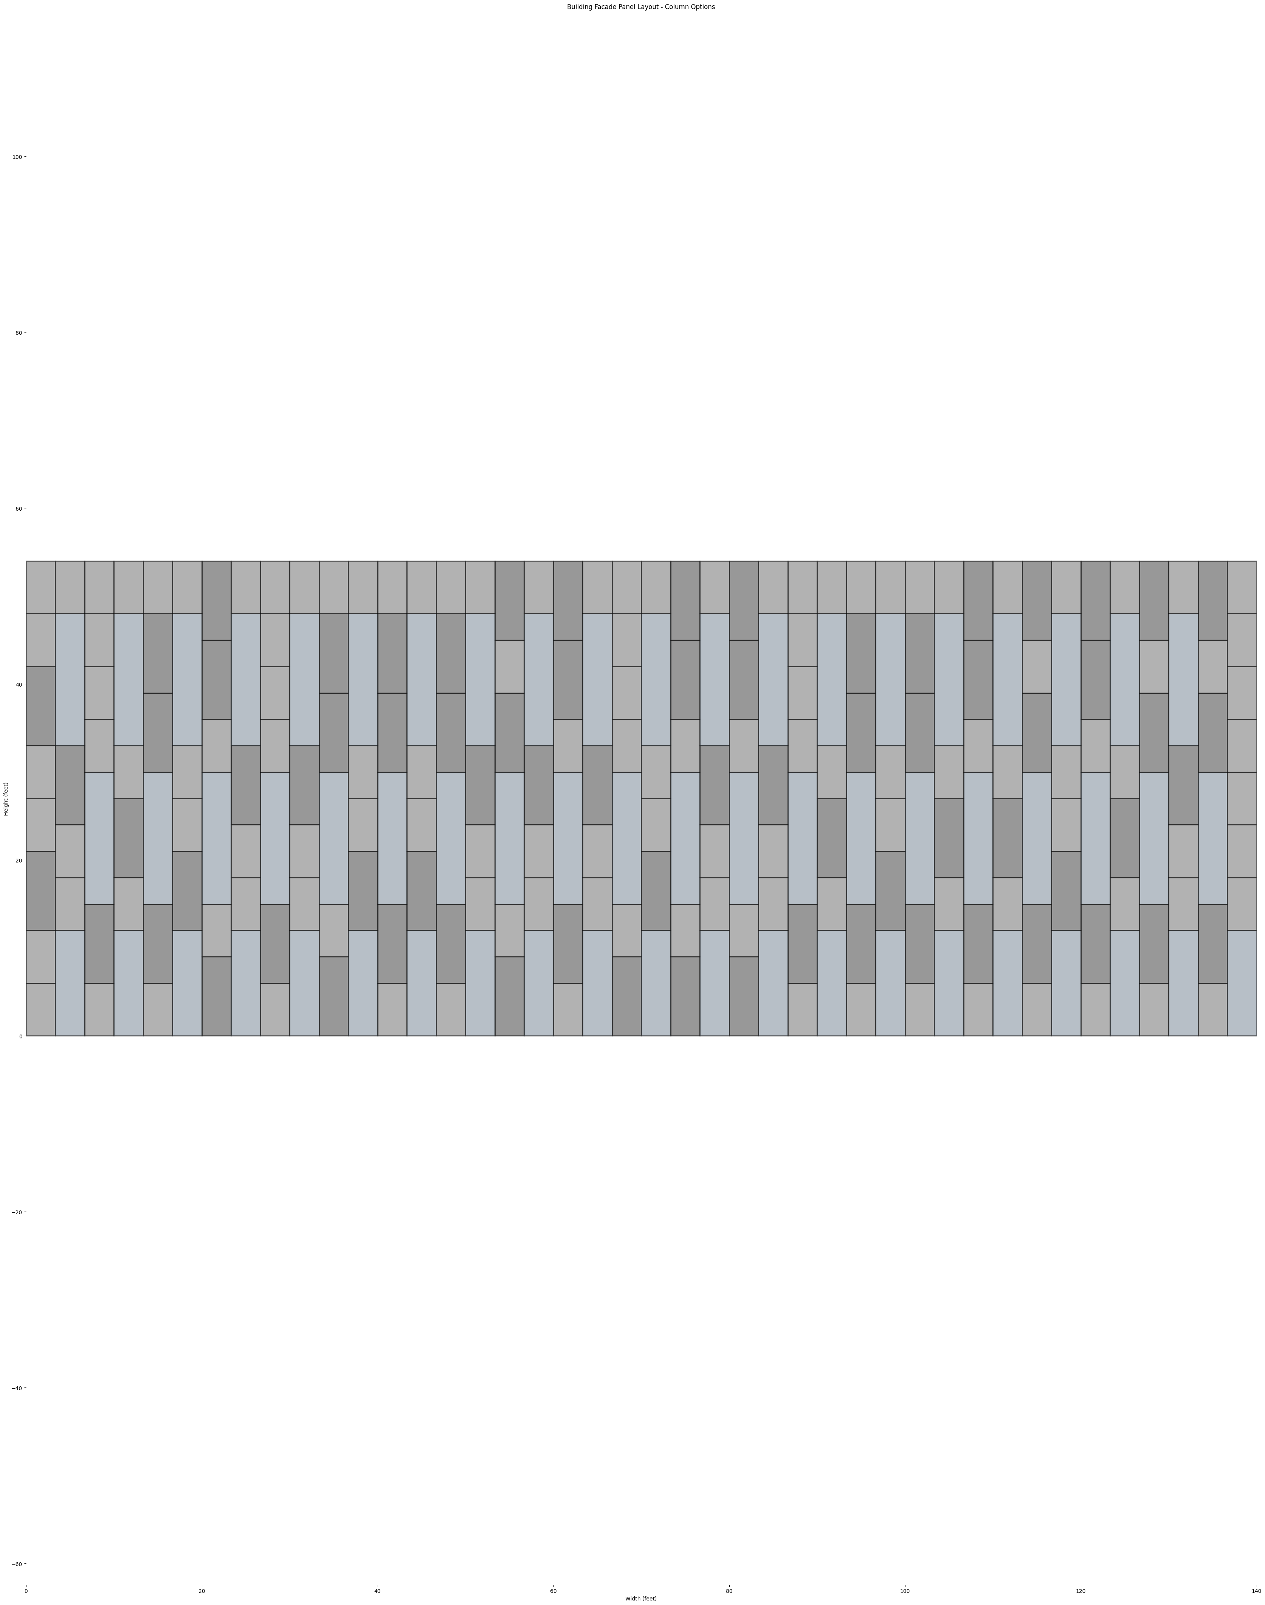
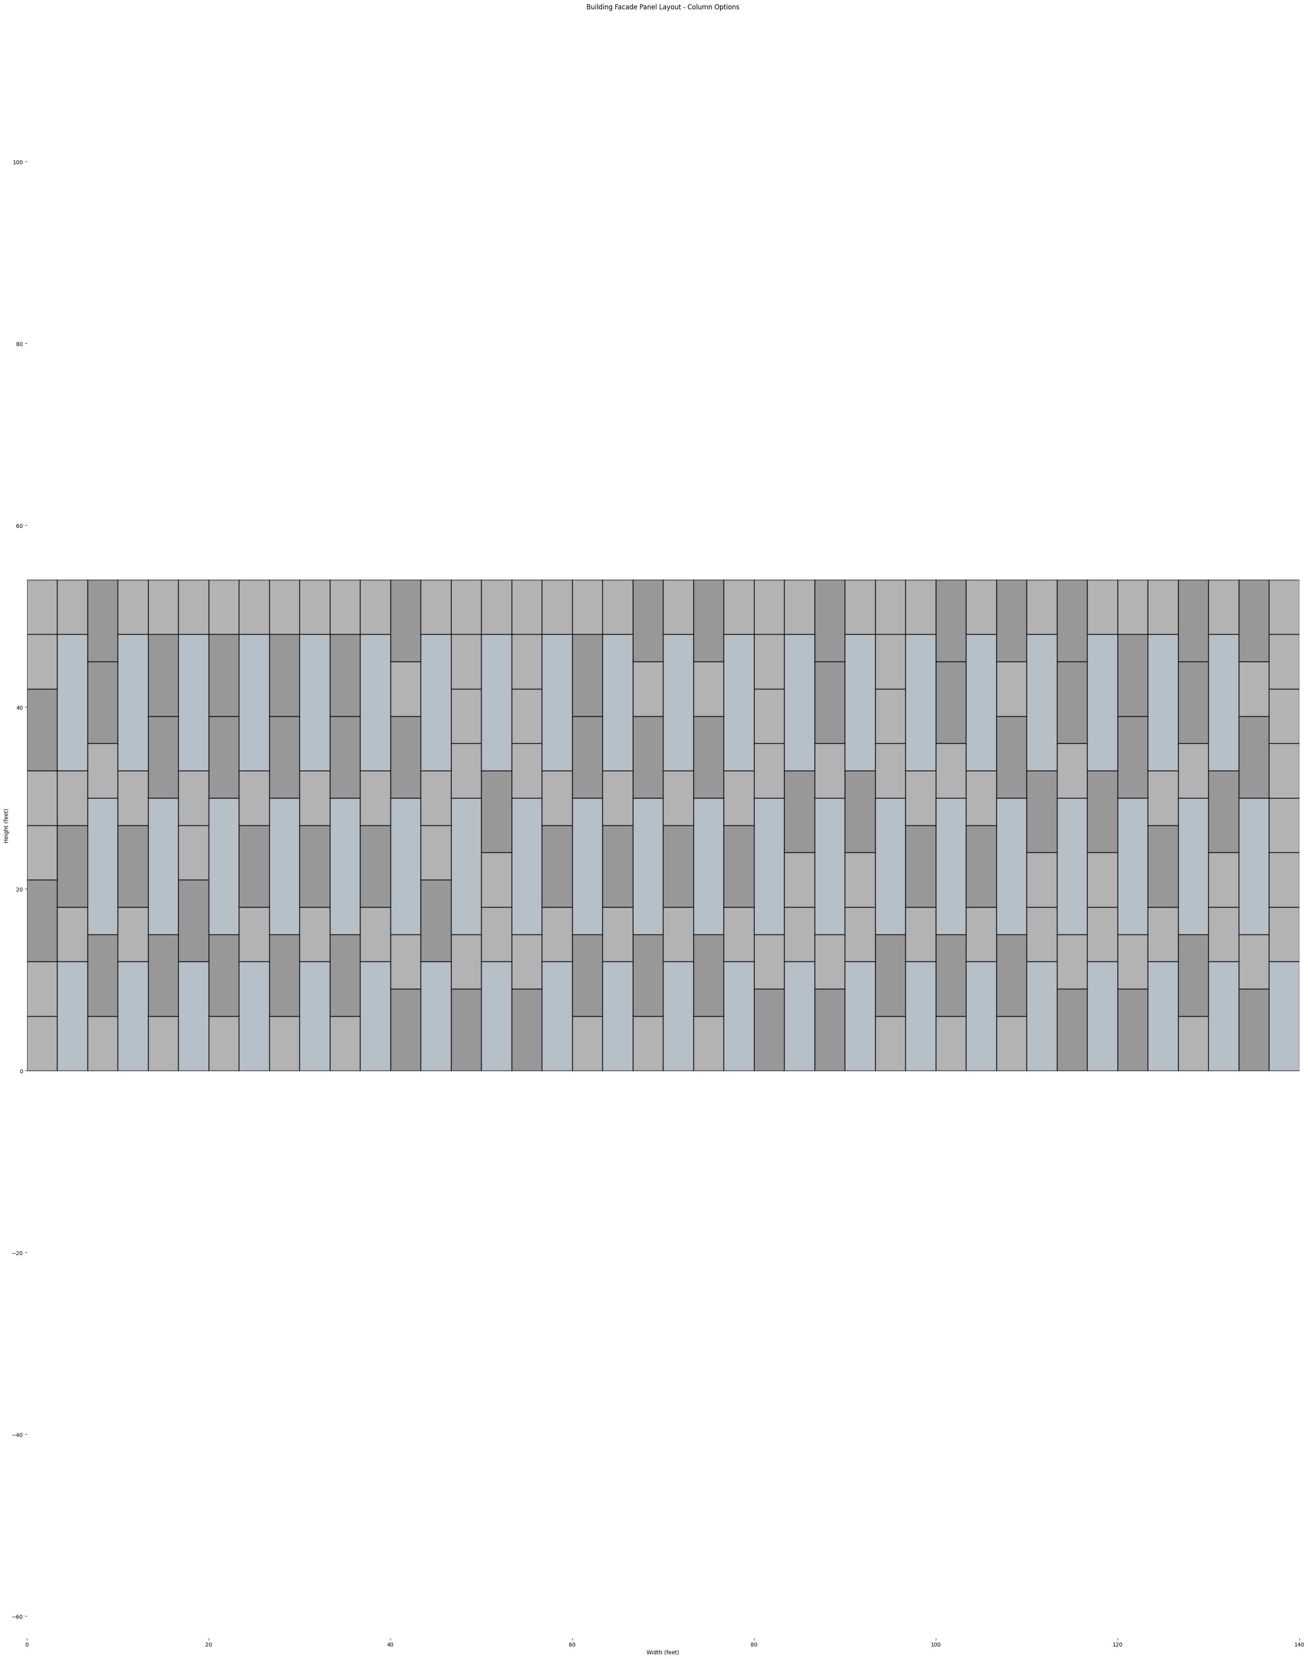
OPTION B

Slide 39
OPTION C
21 Options
8 Options
9 Options
4 Options
3 Options
2 Options
1 Options
Window At Level 1 Only
Window At Level 2 Only
Window At Level 3 Only
Window At Level 1&2
Window At Level 1&3
Window At Level 2&3
Window At Level 1,2&3

Slide 40
OPTION C
42 VERTICAL BAYS
LEVEL 3
20 WINDOWS
LEVEL 2
20 WINDOWS
LEVEL 1
21 WINDOWS
2
1
1
6
6
6
6
6
6
1
1

Slide 41
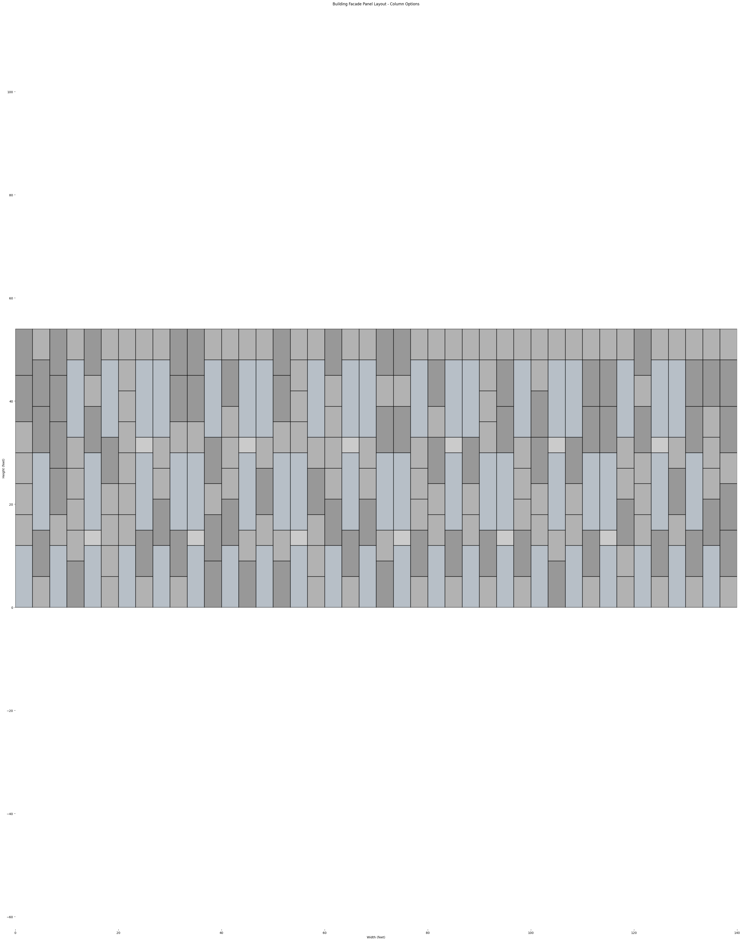
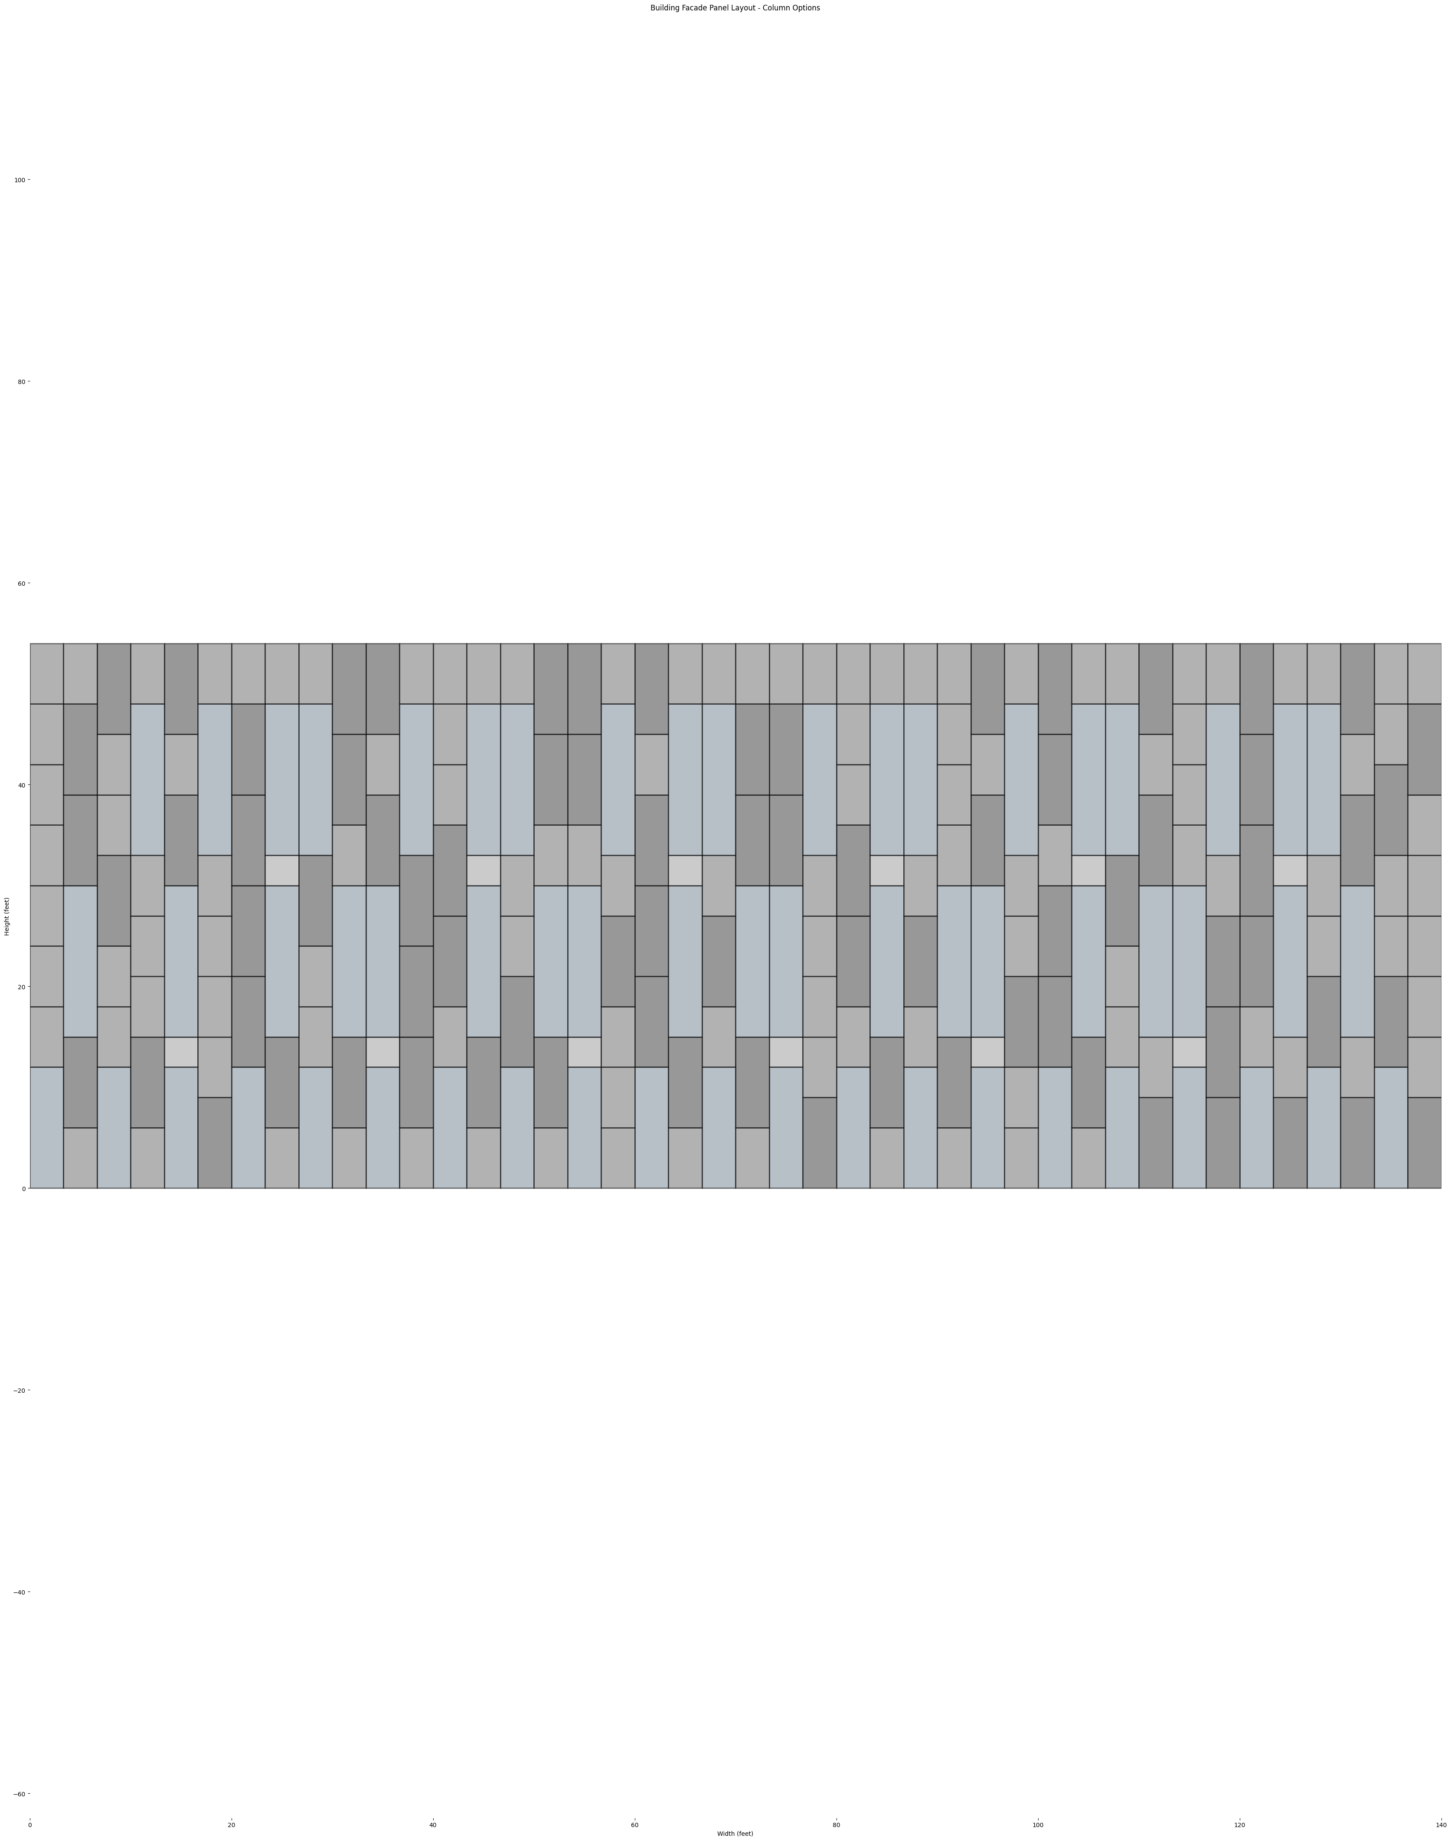
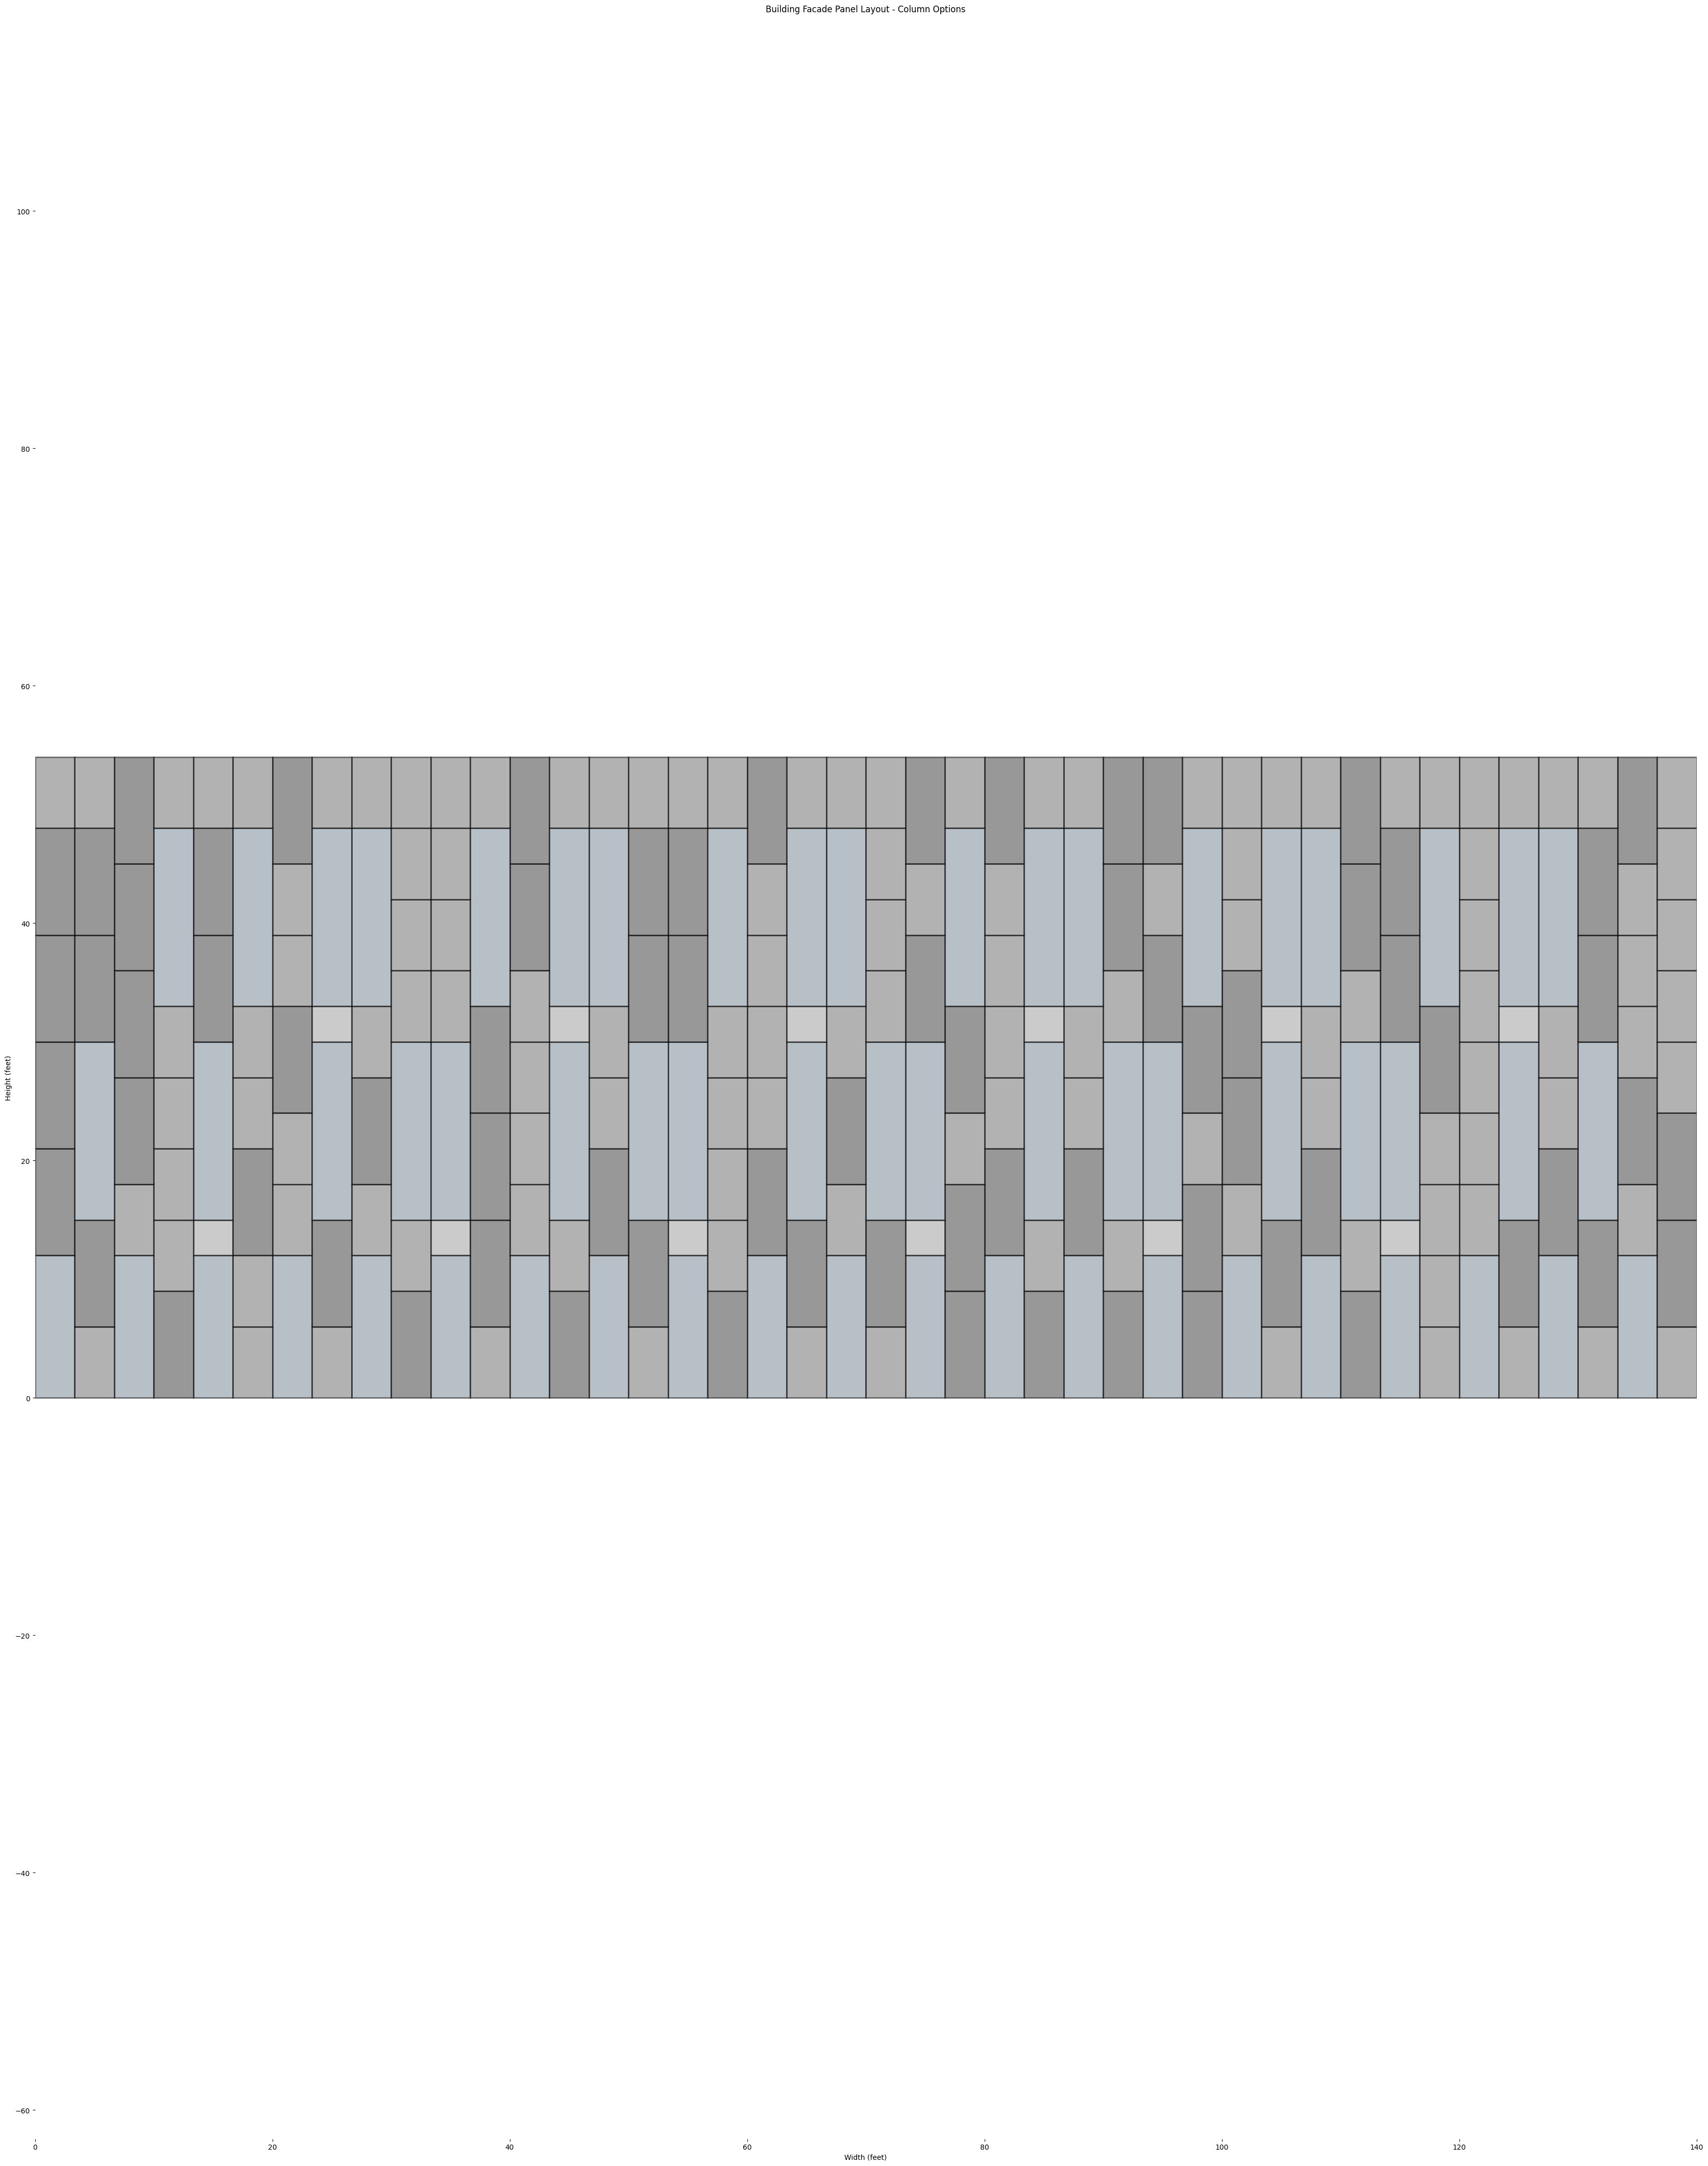
OPTION C

Slide 42
OPTION A
OPTION B
OPTION C

Slide 43
METHOD 2 - Incremental Analysis
42 VERTICAL BAYS
LEVEL 3
LEVEL 2
LEVEL 1

Slide 44
X 2
X 3
X 6
42 Bays X 1
21-bay module
14-bay module
7 –bay module

Slide 45
X 7
X 14
X 21
6-bay module
3-bay module
2-bay module

Slide 46
X 7
X 14
X 21
6-bay module
3-bay module
2-bay module

Slide 47
2-bay Module
X 21
Total of 42 bays
2-bay module
X 20 +
X 2
LEVEL 3
18 – 20 WINDOWS
20 WINDOWS
LEVEL 2
18 – 20 WINDOWS
20 WINDOWS
LEVEL 1
19 - 21 WINDOWS
20 WINDOWS

Slide 48
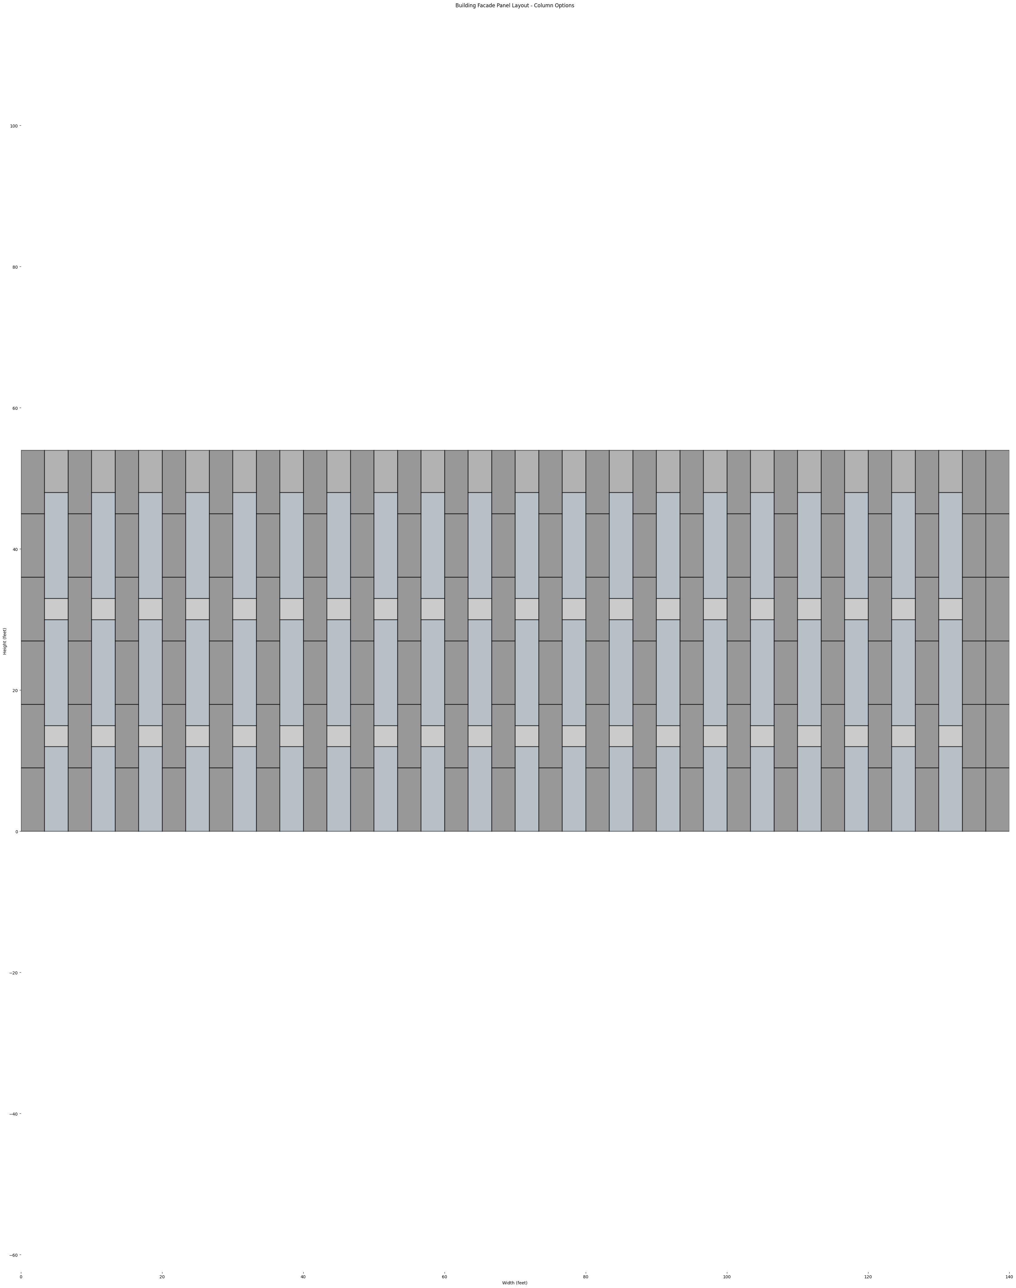
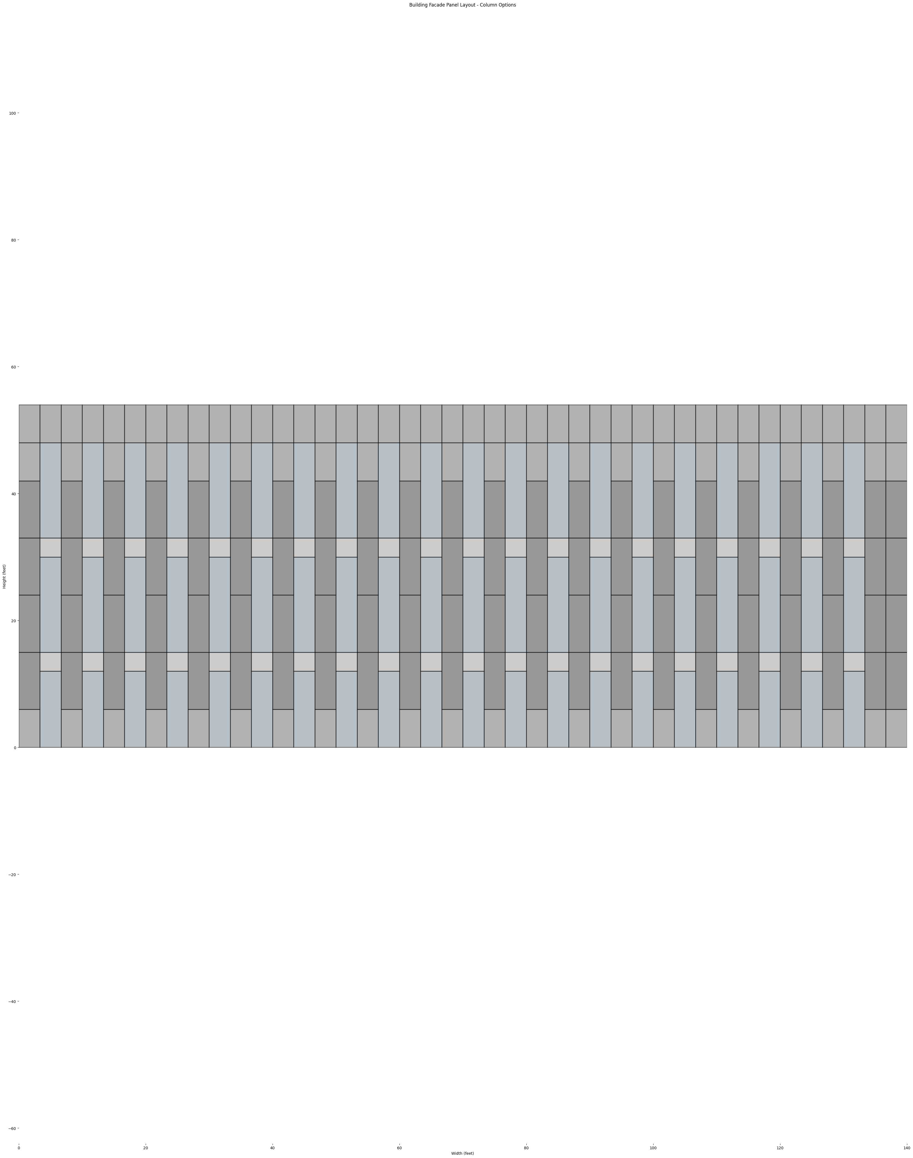
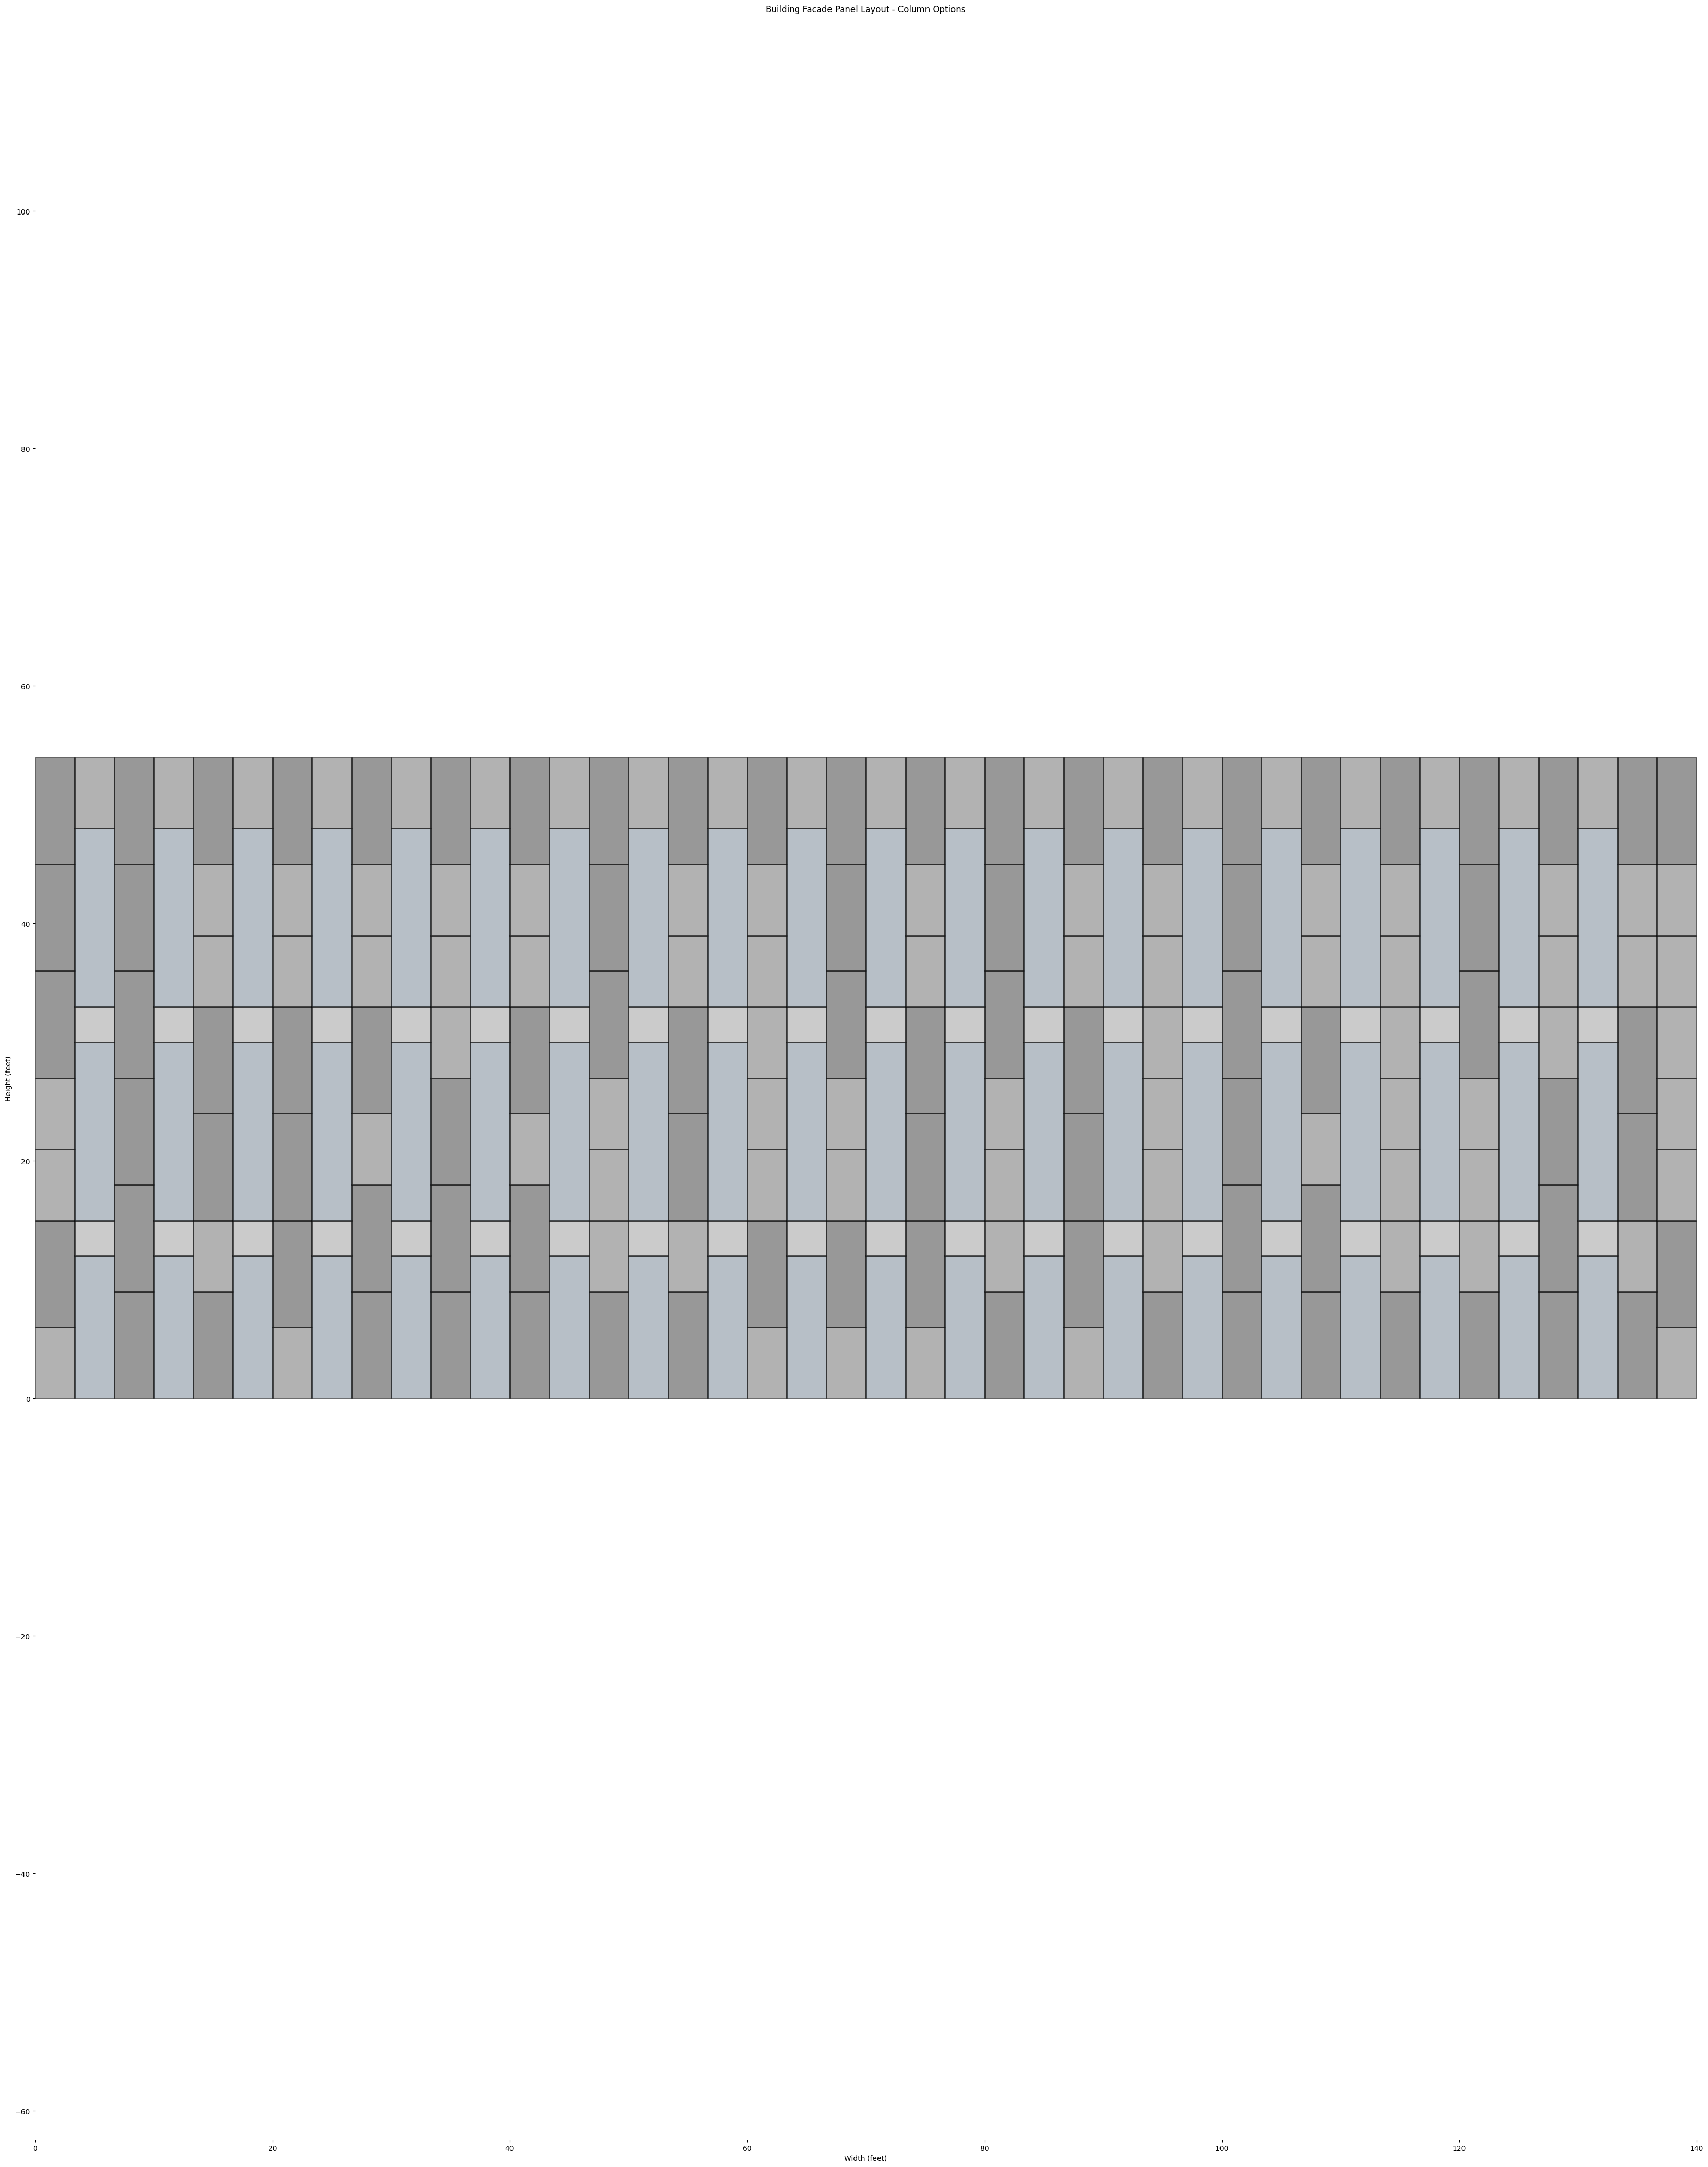
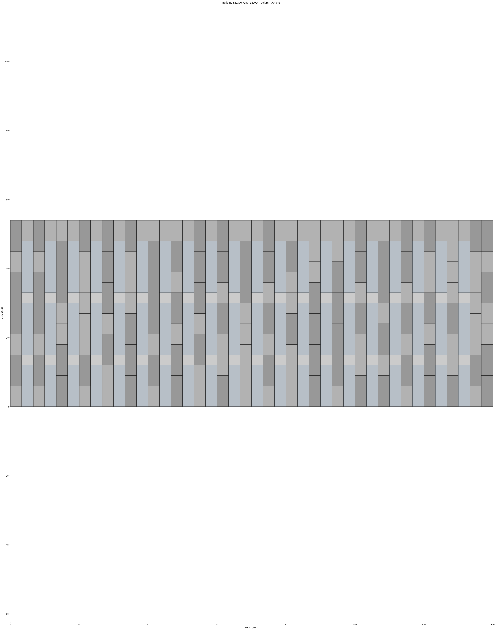
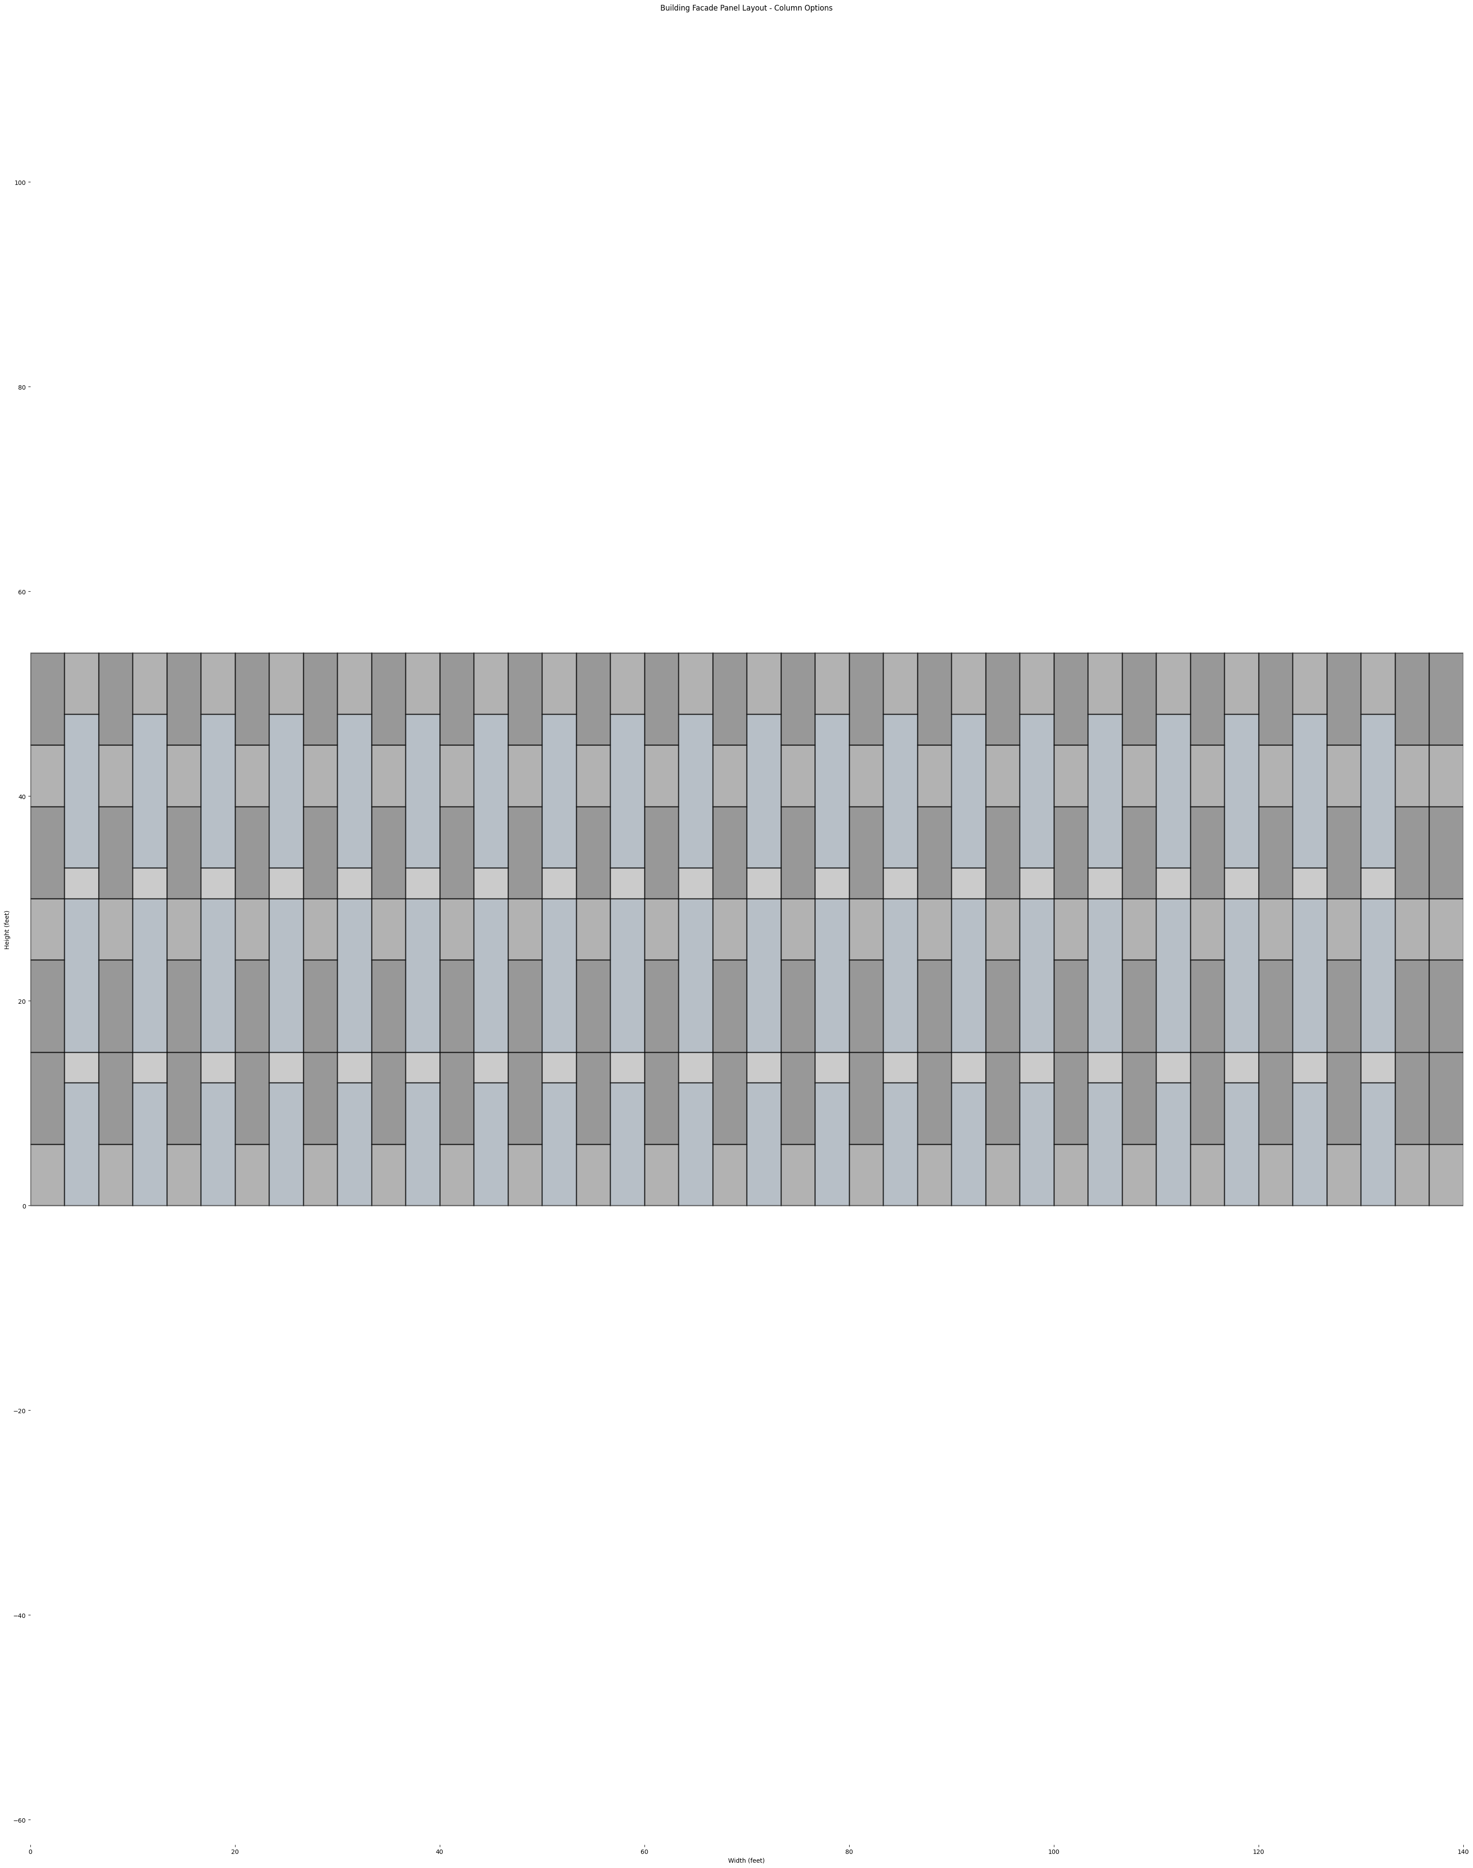
2-bay Module

Slide 49
2-bay Module
X 21
Total of 42 bays
2-bay module
X 20 +
X 2
LEVEL 3
18 – 20 WINDOWS
20 WINDOWS
LEVEL 2
18 – 20 WINDOWS
20 WINDOWS
LEVEL 1
19 - 21 WINDOWS
20 WINDOWS
4 types of
2-bay modules

Slide 50
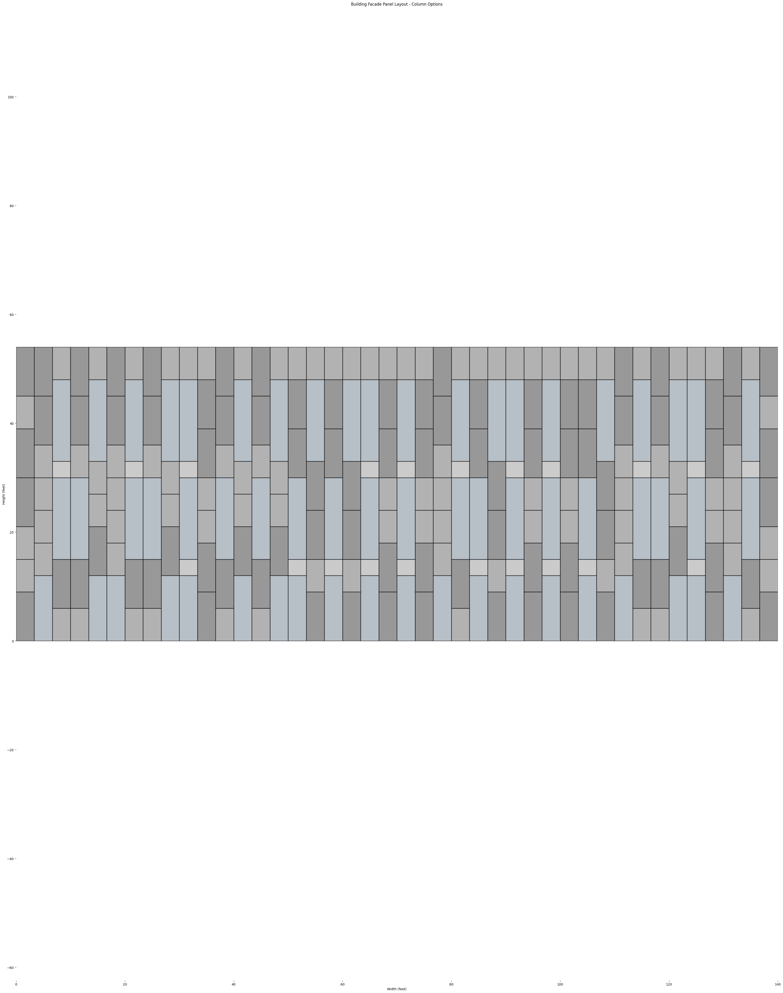
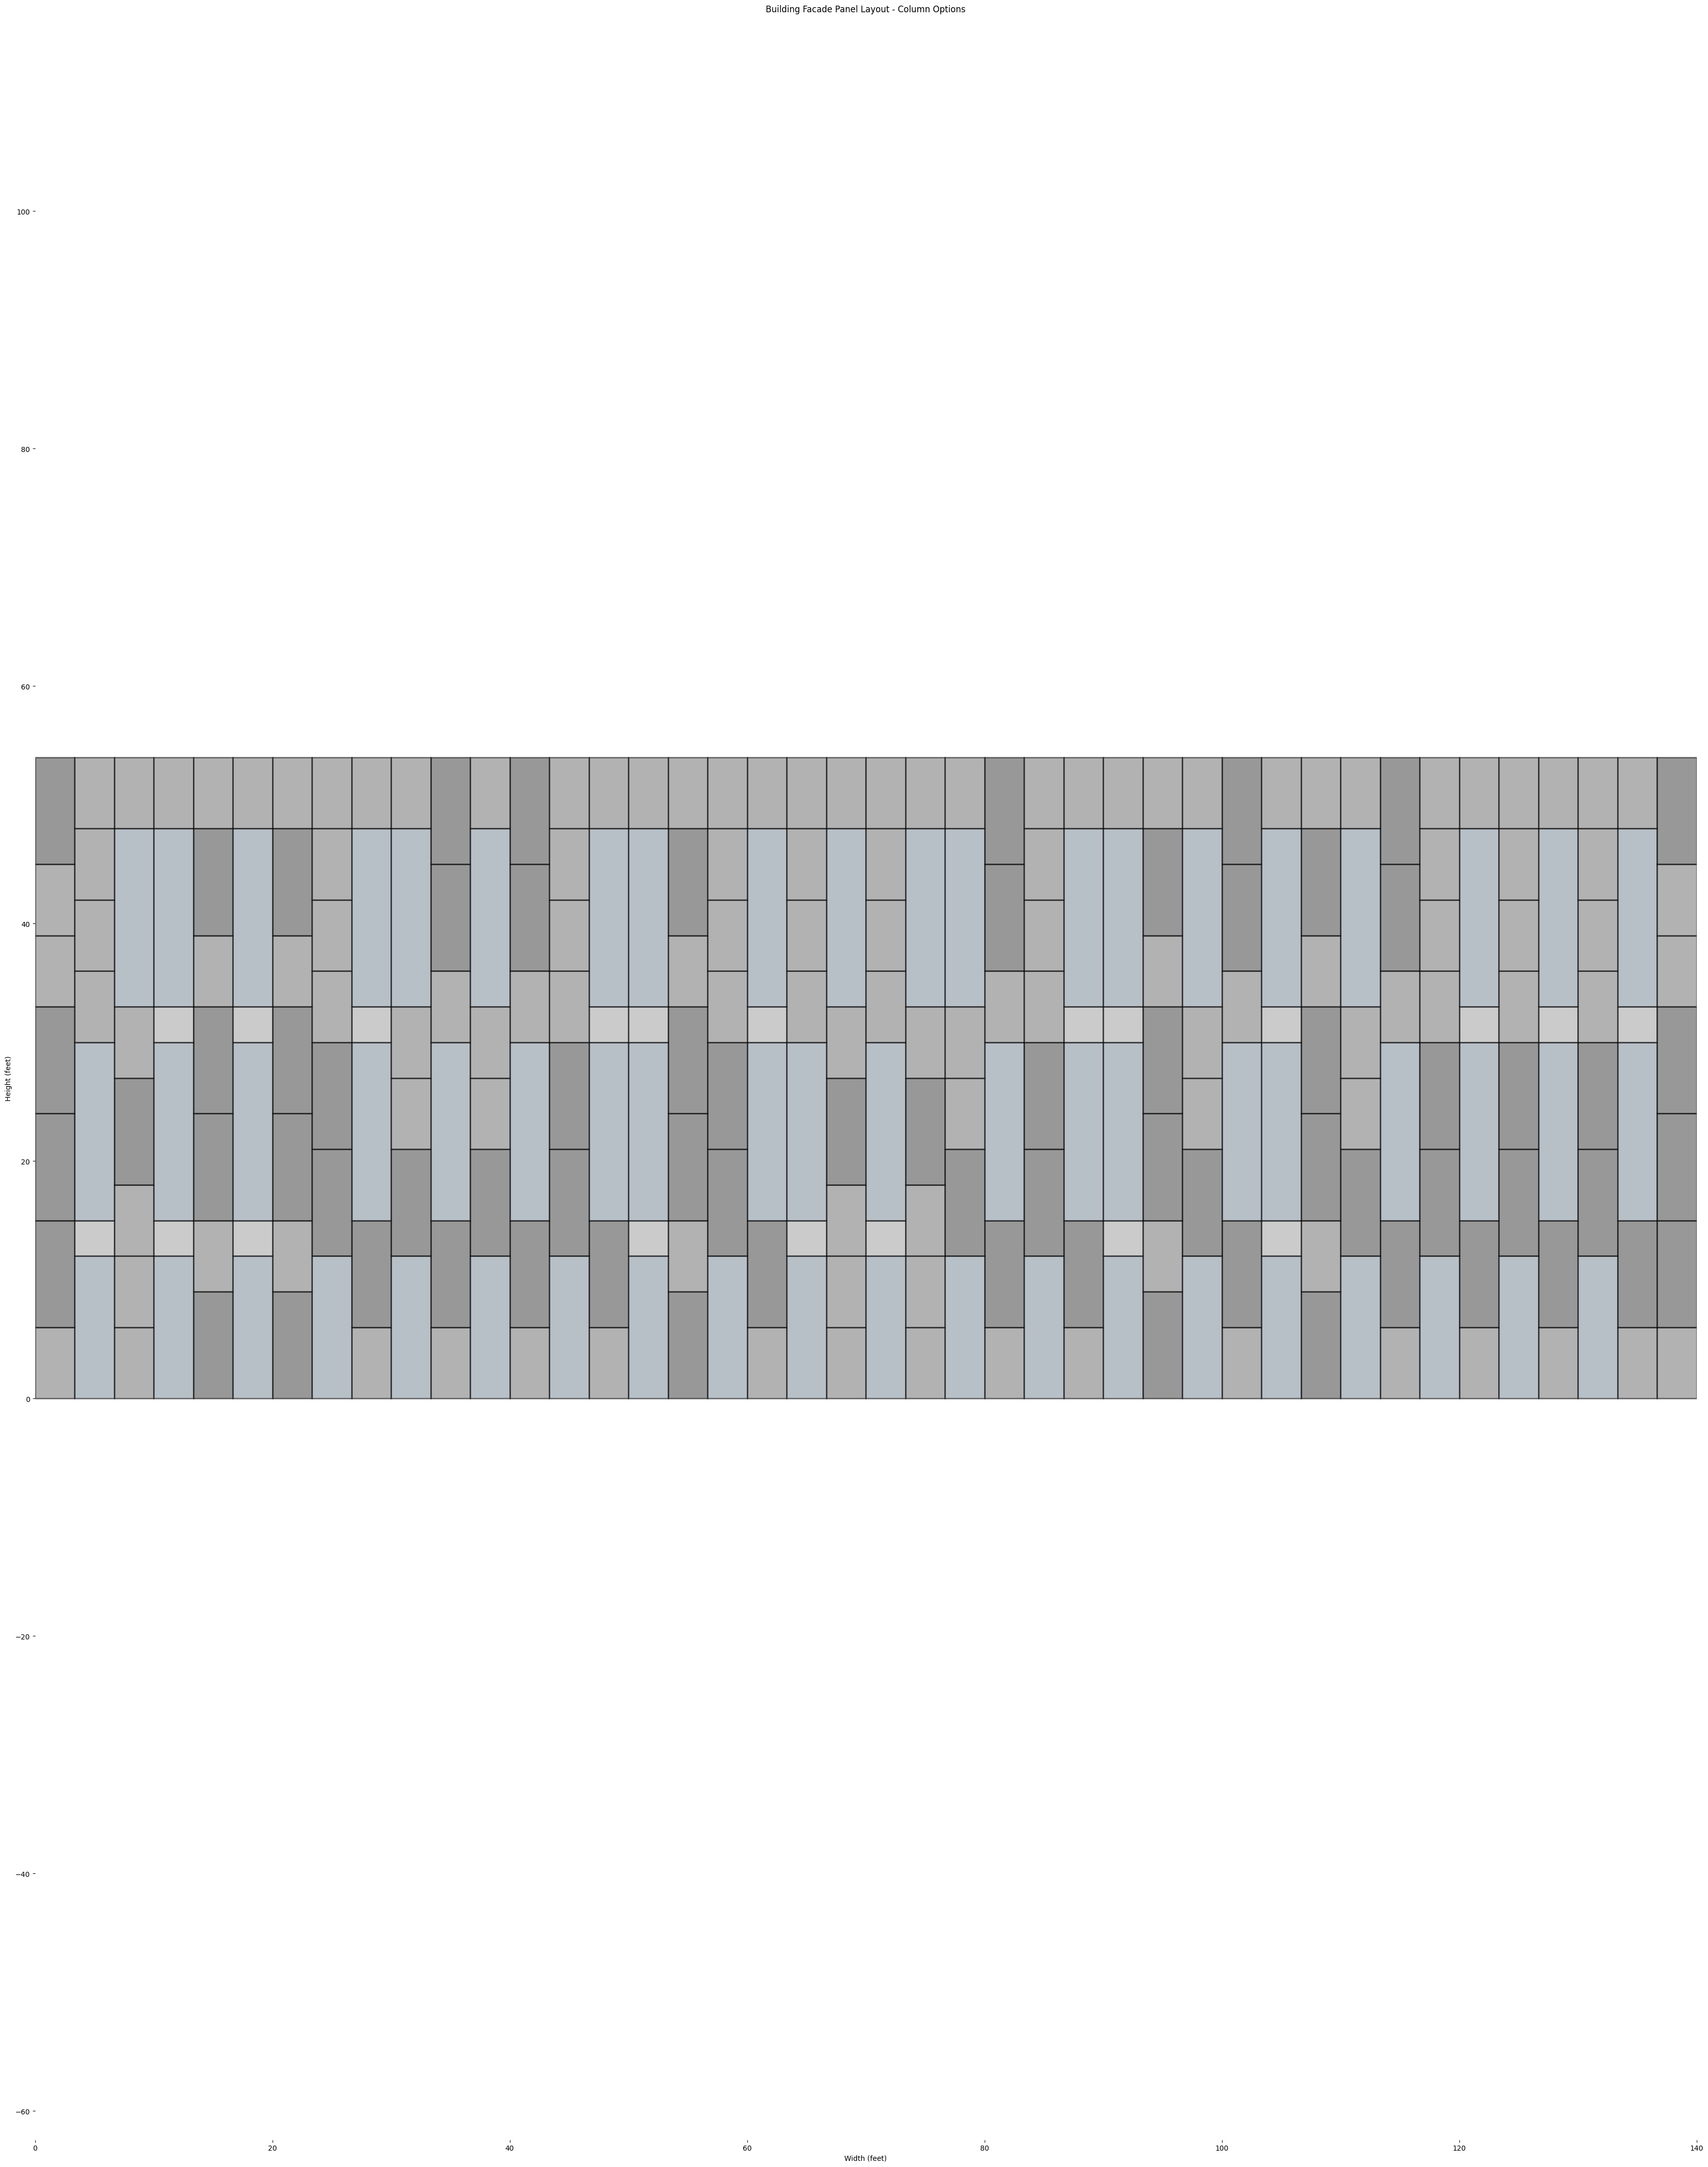
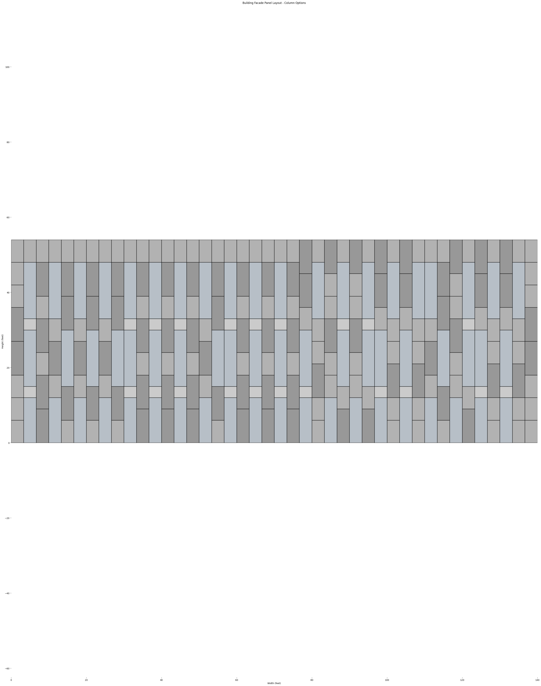
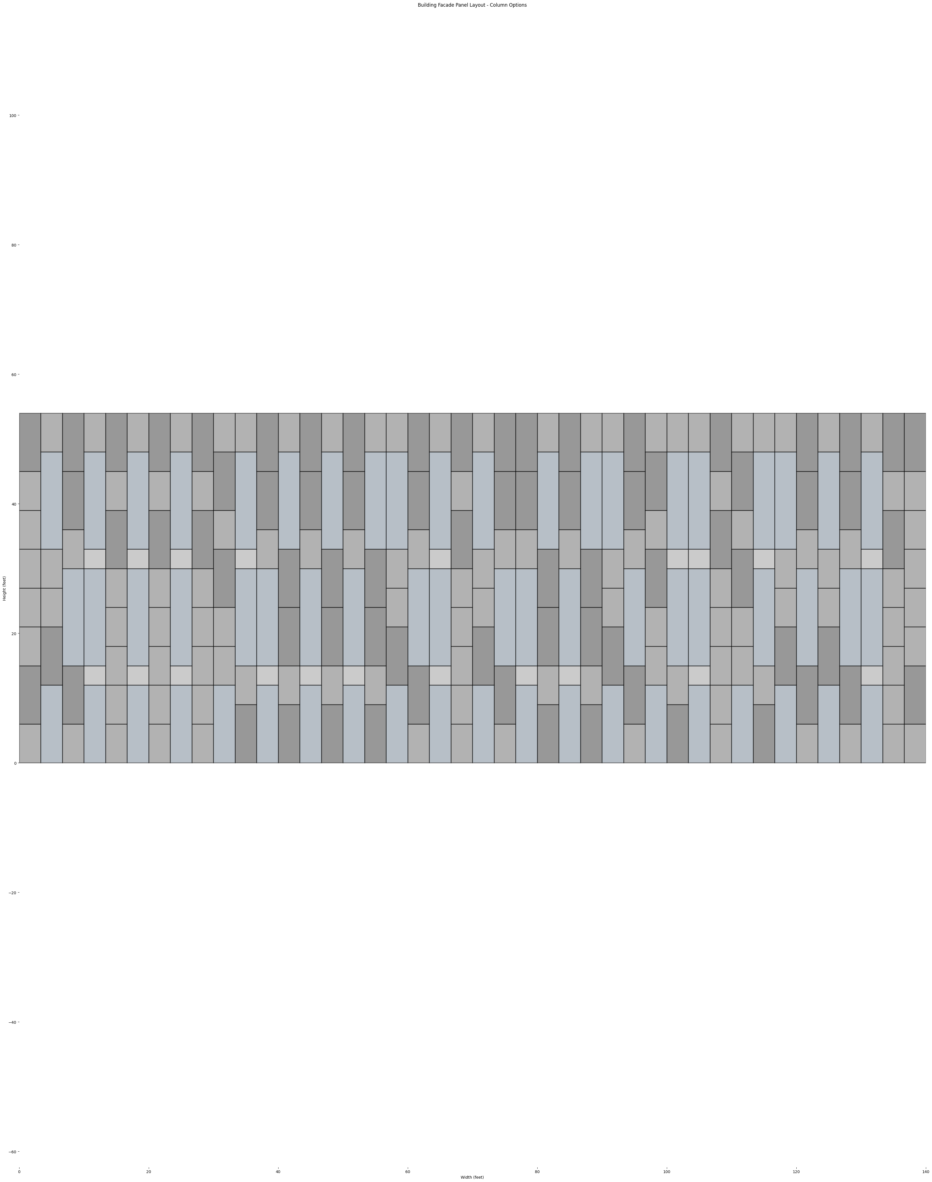
2-bay Module

Slide 51
2-bay Module Samples
OPTION D
OPTION E

Slide 52
OPTION A
OPTION B
OPTION C
OPTION D
OPTION E

